Slide 1
Keeping the equipment safe
All relevant info from today will be available via..

Slide 2
Aims for this talk…
Understanding the Emergency buttons?
How is the quench pipe kept safe?
The importance of the oxygen monitor and how to look after it.
Think about the humidity range for your site.
Know your chiller, cold-head, compressor

Slide 3
Now think for a moment…
You are on the phone to a fire-fighter who needs information NOW and cannot wait for you to arrive.
Describe to the person beside you where your quench button is and how to access it out of hours.
Where is your electrical isolation button and how to access it.
How would you ensure they press the right one!

Slide 6
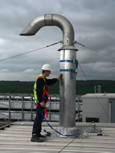

Slide 7
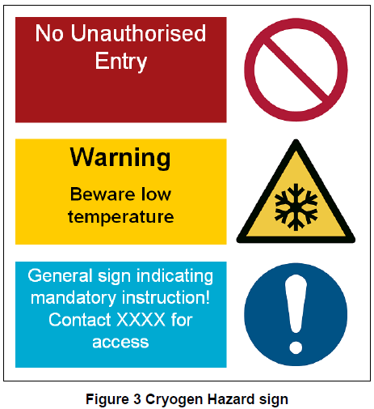
Safe use of equipment Quench pipe safety
A warning sign must be sited at the vent outlet e.g.
Notes:
7
7

Slide 8
Safe use of equipment Quench pipe safety
Issues with the design and maintenance of quench pipes may lead to failure of the pipes during a system quench and the possibility of causing serious injury
Notes:
8
8

Slide 9
Safe use of equipment Quench pipe safety
Design failure case study – A quench pipe was routed through a busy plant room. The pipe was made narrow and the wall thickness increased to compensate for raised pressure.
The issue was that the connection at the magnet would be over pressure in the event of a quench and would have failed. Once discovered, the system had to be taken out of clinical use until it could be rectified.
Notes:
9
9

Slide 10
Safe use of equipment Quench pipes
The external quench pipe terminal must be designed and fitted in such a way to prevent the ingress of rain and snow and foreign bodies, and positioned such that in the event of a quench, no risk will be posed to any individual
Notes:
10
10

Slide 11
Safe use of equipment Quench pipes
Care must be taken to ensure that the vent outlet is positioned a safe distance to any window that can be opened, walkway or escape routes.
Notes:
11
11

Slide 12
Safe use of equipment Quench pipes
The quench pipe must be manufactured and installed in accordance with the material and installation specifications and guidance of the manufacturer.
It is the Board’s Capital Planning Manager’s responsibility, advised by the MRSE, to approve the installation of the quench pipe before the magnet is connected.
Notes:
12
12

Slide 13
Safe use of equipment Quench pipes
The quench pipe is sized correctly to ensure that the pressure created by a quench within the pipe is within the limits of the quench pipe’s pressure capability and the maximum pressure recommended by the manufacturer of the MRI scanner.
We will hold the MR manufacturer’s design calculations on file as part of our Quality System.
Notes:
13
13

Slide 14
Safe use of equipment Quench pipes
In accordance with the recommendations of superconducting MR manufacturers and MHRA, we will ensure annual inspections of all vent piping.
MHRA state that the annual inspection will include, at least, a visual inspection of the external piping.
We will document annual inspections as part of our Quality System.
Notes:
14
14

Slide 15
Safe use of equipment Quench pipes
Routine annual inspection should include the entire length:
Adequate expansion provision/components are fitted
All joints are checked for gas tightness and are in a sound state of repair, including connection to the magnet
Notes:
15
15

Slide 16
Safe use of equipment Quench pipes
Draining of any ‘U’ bends
Notes:
16
16

Slide 17
Remember…?
When designing a suite, ensure that the quench button is easy to access and independent of a lock in an emergency, such as fire, i.e. can you smash a window to get access to it.
An MRI scanner is effectively a bomb (or pressurised vessel) in the building if the quench does not happen properly via the quench pipe due to blockage of other malfunction.

Slide 18
Oxygen monitoring
Do you know where the oxygen cell is and how and when it needs to be replaced?
Who does this?
Find your oxygen sensor - change every
18 months to two years.
Don't wait until the alarm goes off.

Slide 19
Chiller and room conditions
Do you know the normal values for:
chilled water temp, room temperature, room humidity,
chiller water flow rate if available?

Slide 20
Flow meter indicating flow is within normal range

Slide 21
Where is your chiller?

Slide 22
Are you looking after your chiller?
Often they work badly in cold weather and better when able to chill in hot weather.
Who is coming out on Christmas Eve at 4pm when the chiller breaks down?
Continued loss of 6% loss of helium per day can lead to a quench.
Old style scanners lost only up to 1% per day, but new zero-boil-off actually depend even more on a good chiller.
Continued loss of 6% loss of helium per day can lead to a quench.
Is your one covered by Estates, or the vendor, or neither?
When was the water filter last checked as if crud gets into the system then problems…?
Do you have a cold-water bypass on the system?

Slide 23
http://www.hampshirechronicle.co.uk/news/9866186.Winchester_hospital_set_to_replace___800_000_MRI_scanner_destroyed_in_last_year_s_fire/

