Slide 1


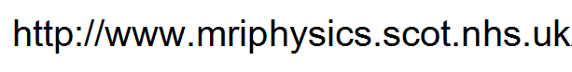
MR Responsible Person Training Event June 2017
Dr John Foster
johnfoster2@nhs.net
All relevant info from today will be available via..

Slide 2
Welcome! Aims for the afternoon…
Ensure that you are more familiar with the role of MR Responsible Person, duties and responsibilities in practice.
Learn more about actually doing the role and share top-tips with colleagues.
Know the MR Safety contact for your site and meet the MR Physics Group
Learn where to find additional teaching courses.
Increase your learning about Hot Topics in MR Safety.
Have opportunity to give feedback on support needed

Slide 3
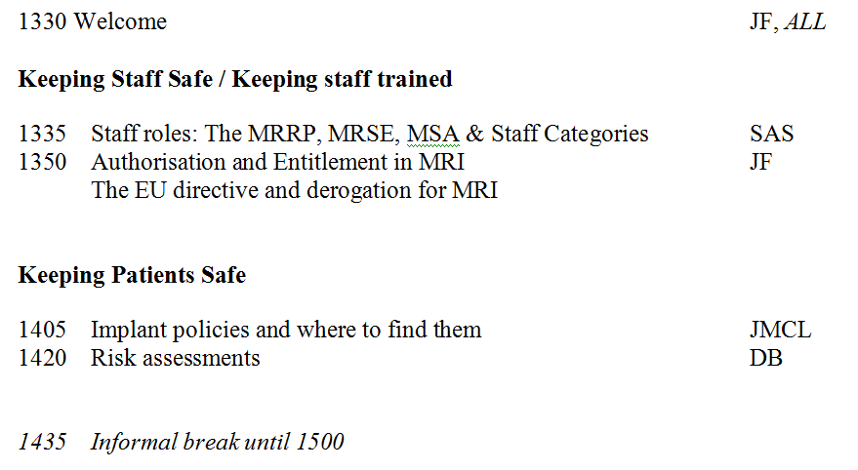
Programme

Slide 4
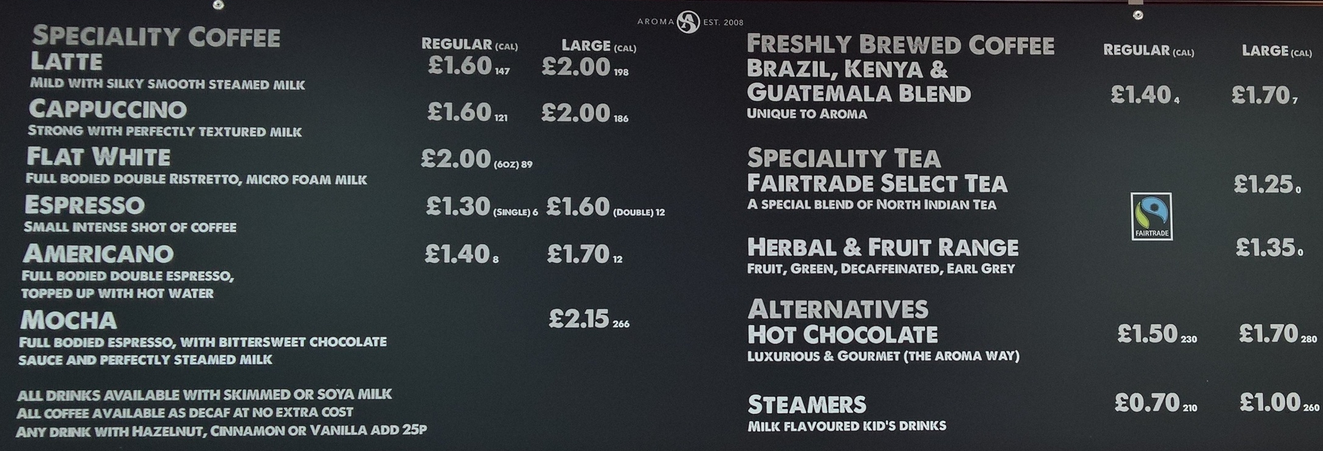
Please sign in and pre-book your interval drink!

Slide 5
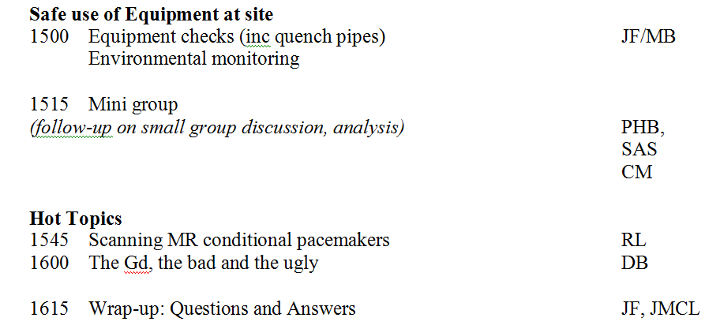
Programme

Slide 6
Your Safety Support
Know the MR Safety support contact for your site and meet the MR Physics Group
Dr John Foster
Dr John McLean
Dr David Brennan
Dr Pauline Hall Barrientos
Dr Sarah Allwood-Spiers
Dr Rosario Gonzalez-Lopez

Slide 7
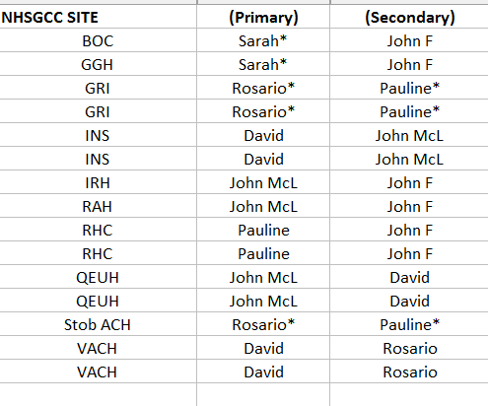

Slide 8
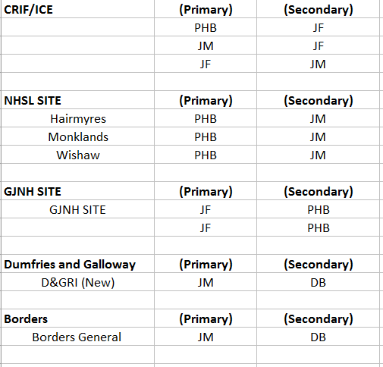

Slide 9
Over to Sarah….

Slide 10
Authorisation and Entitlement
In NHSGGC, a process similar to Ionising Radiation staff and IRMER
regulations has been rolled out using two key terms: Authorisation and Entitlement
Only staff that need to be MRI trained, should be trained, decided
by entitlement.
When the staff are actually trained then there is sign off by both
MRRP and appropriate management.
Notes:
10

Slide 11
Authorisation and Entitlement
Being signed off by the MRRP will include a training package and
appropriate safety competences are worked through and
achieved.
It is not possible for staff to simply turn up to work in MRI or to
expect training there if they are not entitled.
The system ensures that we have training structures in place for
relevant staff and control over who actually needs to be
trained.

Slide 12
Authorisation and Entitlement
There is also now the need to check by relevant like managers
that staff are properly trained to their level of entitlement.
Do you understand the process of who does what in each
section? And what is each section?

Slide 13
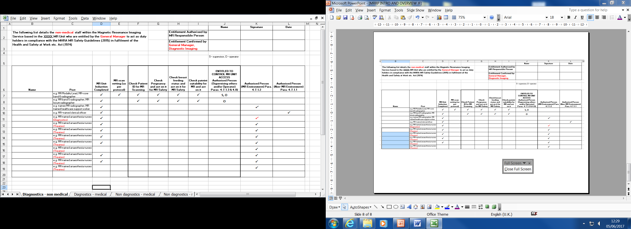
Authorisation and Entitlement
The overview spreadsheet for the MRRP….

Slide 14
Authorisation and Entitlement

Slide 15
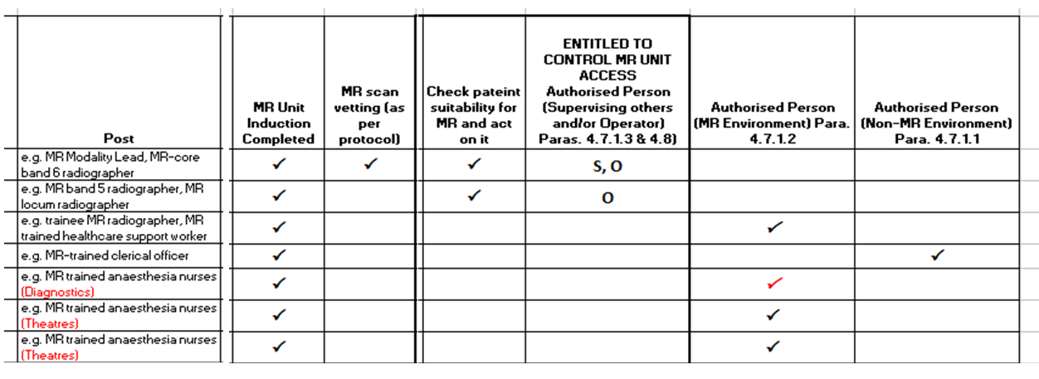
Authorisation and Entitlement

Slide 16
Authorisation and Entitlement
Training Package A
Authorised MR Environment; Operator or Supervisor and controlling access to the MR Controlled Access Area
Training Package B
Authorised MR Environment; but NOT Operator or Supervisor
Training Package C
Authorised Non-MR Environment; and needing MR Environment access under supervision.
Training Package D
Authorised Non-MR Environment.

Slide 18
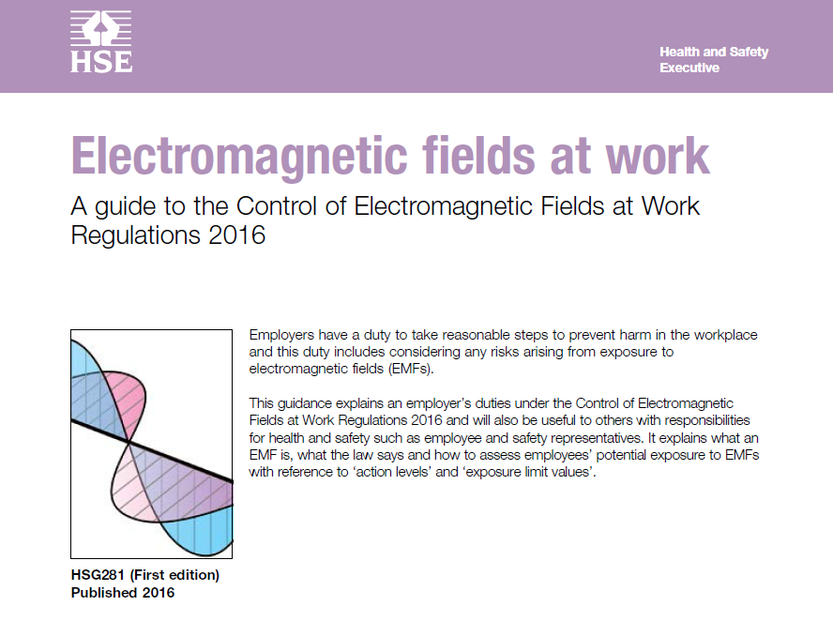

Slide 19
EMF at work – UK law Aims for this talk
Ensure that you are familiar with EMF in the work place.
Appreciate how the MR Safety Experts can assist with any aspects that may arise.
Notes:
19

Slide 20
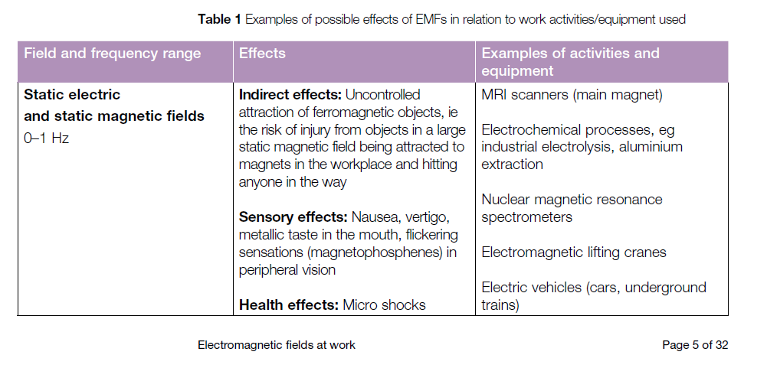
EMF at work – UK law

Slide 21
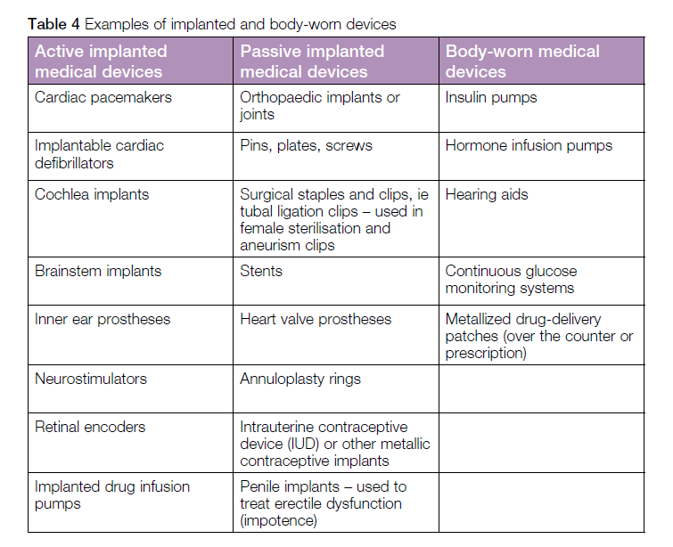
EMF at work – UK law

Slide 22
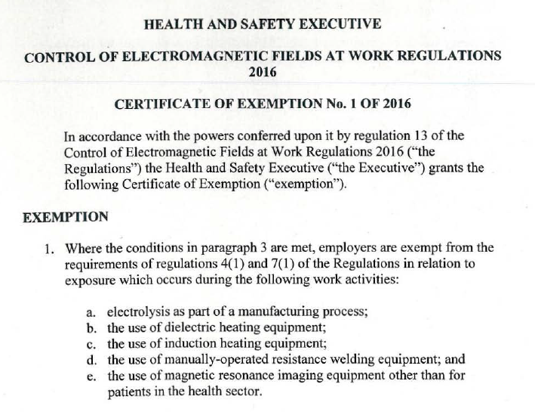
EMF at work – UK law
Regular NHS scanning does not need an “exemption”, it already is!

Slide 23
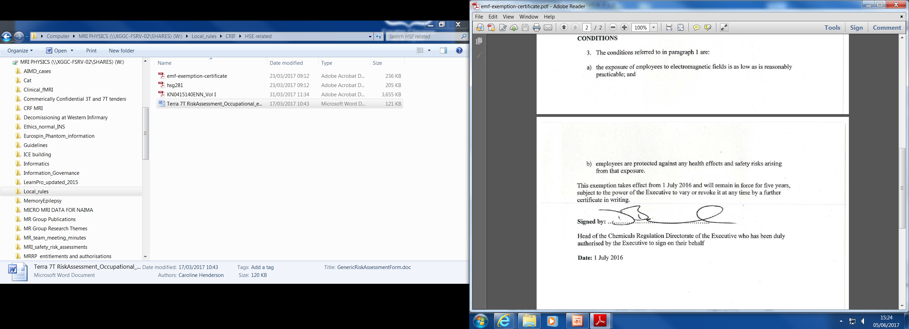
EMF at work – UK law

Slide 24
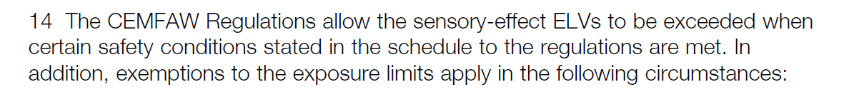
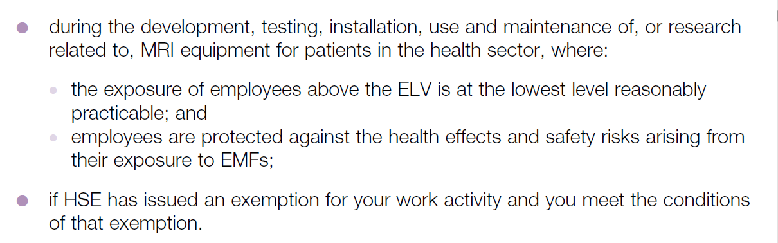
EMF at work – UK law

Slide 25
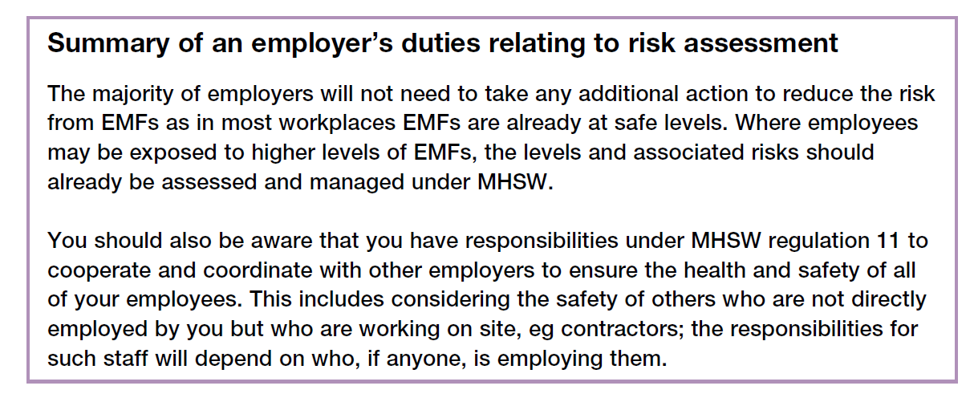
EMF at work – UK law

Slide 26
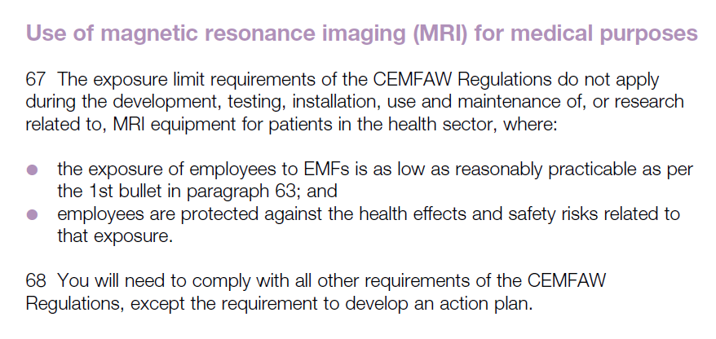
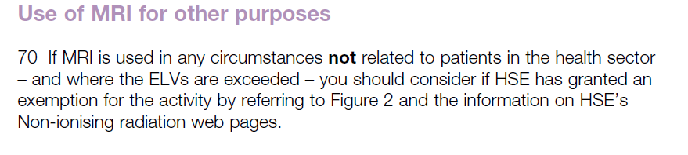
EMF at work – UK law

Slide 27
