Slide 1
Risk Assessment Huh! What Is It Good For?
Definitely Something
Dr David Brennan
dbrennan@nhs.net

Slide 2
Definition
“a systematic process of evaluating the potential risks that may be involved in a projected activity or undertaking.”
Google

Slide 3
Definition
“A risk assessment is a systematic examination of a task, job or process that you carry out at work for the purpose of identifying the significant hazards, the risk of someone being harmed and deciding what further control measures you must take to reduce the risk to an acceptable level.”
https://www.hsdirect.co.uk/free-info/risk-assessment.html

Slide 4
Definition
“A risk assessment is a systematic examination of a task, job or process that you carry out at work for the purpose of identifying the significant hazards, the risk of someone being harmed and deciding what further control measures you must take to reduce the risk to an acceptable level.”
https://www.hsdirect.co.uk/free-info/risk-assessment.html

Slide 5
Definition
Identifying the significant hazards that are present (a hazard is something that has the potential to cause someone harm or ill health).
Deciding if what you have already done reduces the risk of someone being harmed to an acceptable level, and if not;
Deciding what further control measures you must take to reduce the risk to an acceptable level.

Slide 6
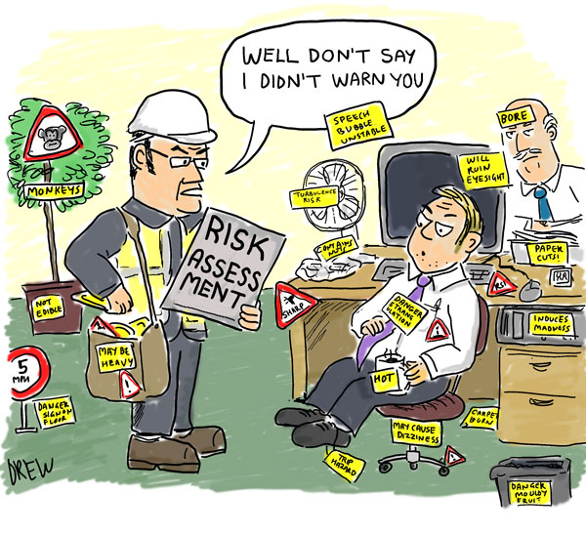
Significant Hazards

Slide 7
Significant Hazards
Something that is specific to that environment and not just risks you experience in normal daily life
Does not just need to be MR related
Work environment related
i.e. anaesthesia, flood (it has happened!), lone working etc

Slide 8
Important Clarification
A risk assessment is not about creating huge amounts of paperwork, but rather about identifying sensible measures to control the risks in your workplace.
Health and Safety Executive
Reality is that initially it can take a while to set up.
Less onerous once initial assessments complete.

Slide 9
Risk Assessment Methods
Identify the hazards
Identify those at risk
Identify existing control measures
Evaluate the risk
Decide/Implement control measures
Record assessment
Monitor and review
Inform

Slide 10
Risk Assessment Methods
Identify the hazards – Donald Trump falling asleep & hitting red button
Identify those at risk
Identify existing control measures
Evaluate the risk
Decide/Implement control measures
Record assessment
Monitor and review
Inform

Slide 11
Risk Assessment Methods
Identify the hazards – Donald Trump falling asleep & hitting red button
Identify those at risk – Everyone in the world
Identify existing control measures
Evaluate the risk
Decide/Implement control measures
Record assessment
Monitor and review
Inform

Slide 12
Risk Assessment Methods
Identify the hazards – Donald Trump falling asleep & hitting red button
Identify those at risk – Everyone in the world
Identify existing control measures – Drink coffee & secret service move button
Evaluate the risk
Decide/Implement control measures
Record assessment
Monitor and review
Inform

Slide 13
Risk Assessment Methods
Identify the hazards – Donald Trump falling asleep & hitting red button
Identify those at risk – Everyone in the world
Identify existing control measures – Drink coffee & secret service move button
Evaluate the risk – Likely to happen and extreme consequences!
Decide/Implement control measures
Record assessment
Monitor and review
Inform

Slide 14
Risk Assessment Methods
Identify the hazards – Donald Trump falling asleep & hitting red button
Identify those at risk – Everyone in the world
Identify existing control measures – Drink coffee & secret service move button
Evaluate the risk – Likely to happen and extreme consequences!
Decide/Implement control measures – More Golf, pokey stick, & better button
Record assessment
Monitor and review
Inform

Slide 15
Risk Assessment Methods
Identify the hazards – Donald Trump falling asleep & hitting red button
Identify those at risk – Everyone in the world
Identify existing control measures – Drink coffee & secret service move button
Evaluate the risk – Likely to happen and extreme consequences!
Decide/Implement control measures – More Golf, pokey stick, & better button
Record assessment – Risk Assessment Document
Monitor and review
Inform

Slide 16
Risk Assessment Methods
Identify the hazards – Donald Trump falling asleep & hitting red button
Identify those at risk – Everyone in the world
Identify existing control measures – Drink coffee & secret service move button
Evaluate the risk – Likely to happen and extreme consequences!
Decide/Implement control measures – More Golf, pokey stick, & better button
Record assessment – Risk Assessment Document
Monitor and review – Once a presidential term?
Inform

Slide 17
Risk Assessment Methods
Identify the hazards – Donald Trump falling asleep & hitting red button
Identify those at risk – Everyone in the world
Identify existing control measures – Drink coffee & secret service move button
Evaluate the risk – Likely to happen and extreme consequences!
Decide/Implement control measures – More Golf, pokey stick, & better button
Record assessment – Risk Assessment Document
Monitor and review – Once a presidential term?
Inform – Show Spicer where pokey stick is. Secret service to make new button

Slide 18
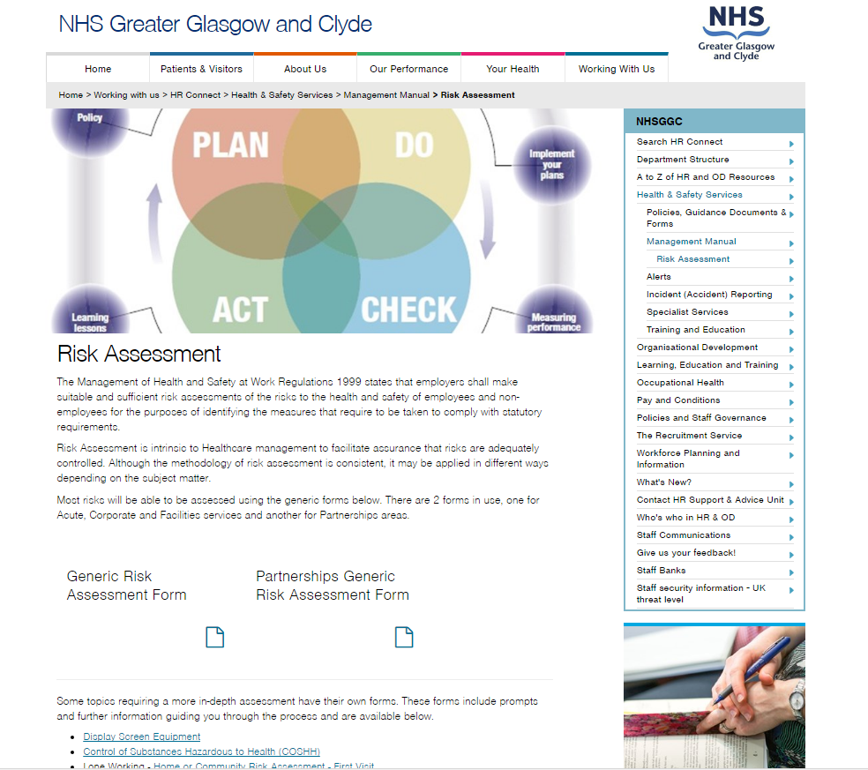
Form from where?
Forms can be downloaded from:
http://www.nhsggc.org.uk/working-with-us/hr-connect/health-safety/management-manual/risk-assessment/
To find it, just Google:
Risk assessment NHSGGC

Slide 19
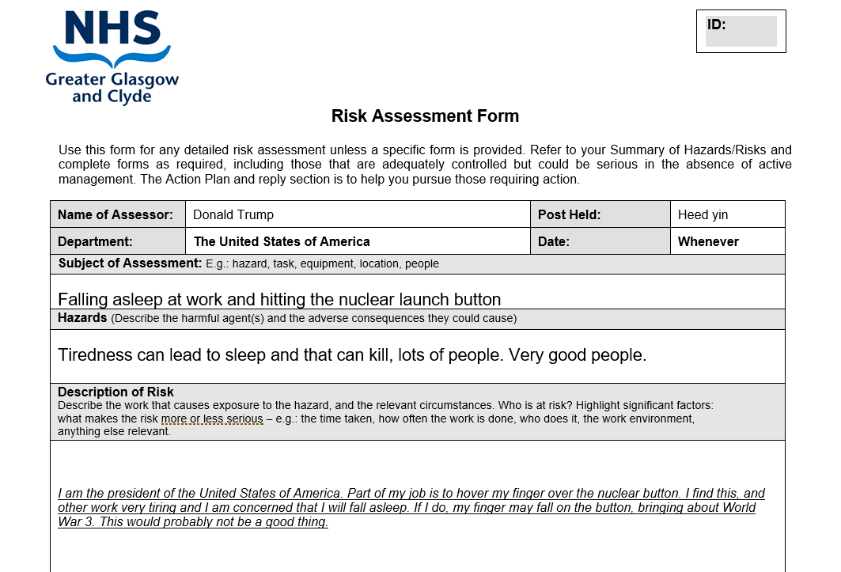
Filling the form

Slide 20
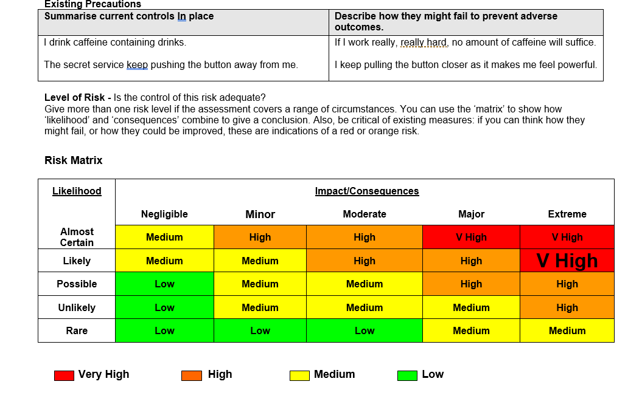
Filling the form

Slide 21
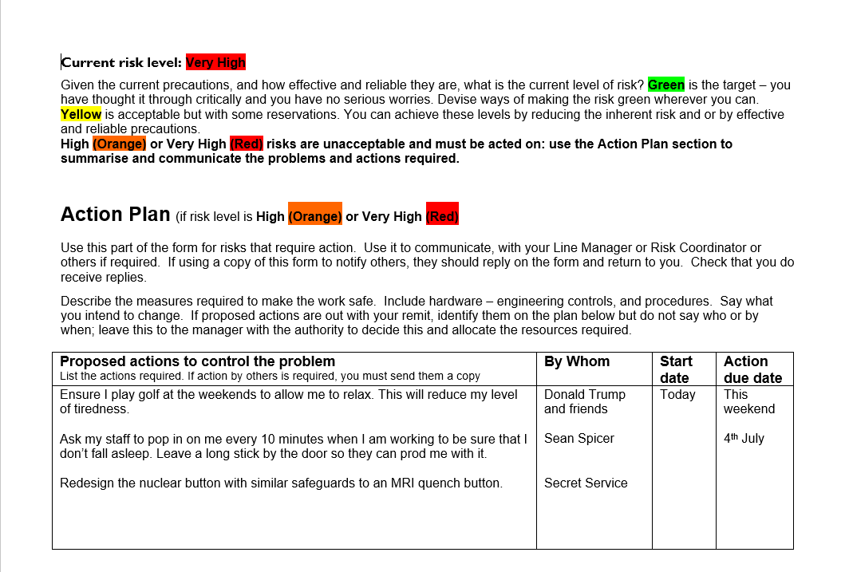
Filling the form

Slide 22
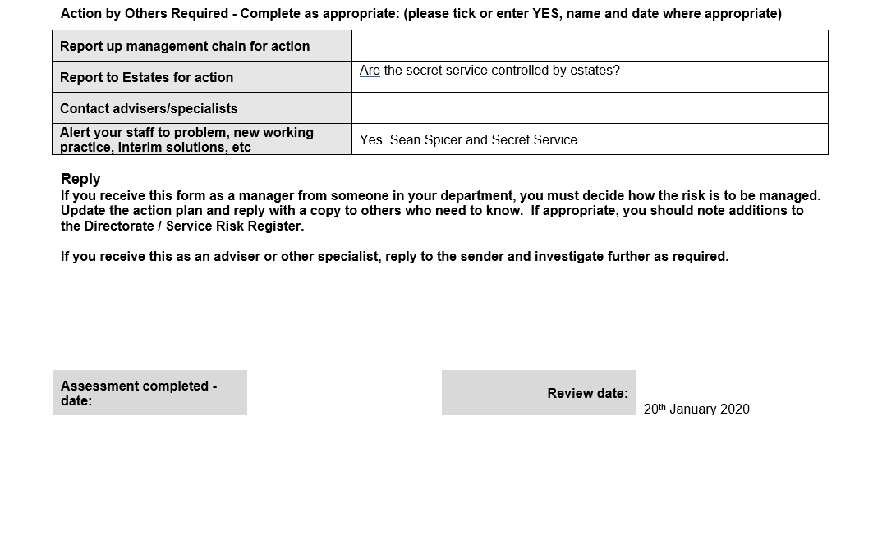
Filling the form

Slide 23
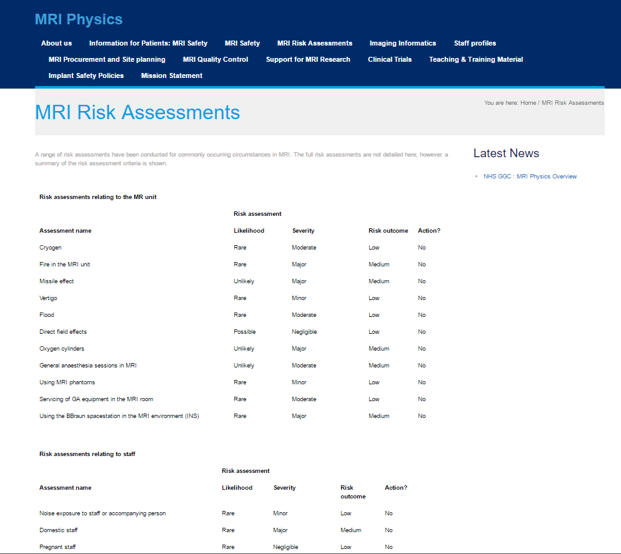
So Where do I Start!?
DON’T PANIC!!
http://www.mriphysics.scot.nhs.uk/mri-risk-assessments/

Slide 24
Who can help!?

Slide 25
Who can help!?

