Slide 1
Staff roles: The MRRP, MRSE, & Staff Categories
Sarah Allwood-Spiers
MRI Physics
7th June 2017

Slide 2
Staff roles: Guidelines
The MHRA safety guidelines (2015) set out staff roles for MR Responsible Person, MR Safety Expert, MR Authorised Person
And categories of staff who access the MR contolled access area (CAA).
Our local rules follow these guidelines.
“Safety Guidelines for Magnetic Resonance Imaging Equipment in Clinical Use”, MHRA 2015, v 4.2

Slide 3
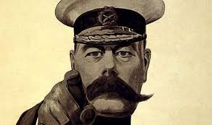
MR Responsible Person
Purpose and role
Delegated by Chief Executive or General Manager
Day-to-day responsibility for safety
Provides continuity and consistency for the ongoing safe working practices of the department.
Provides continuity when dealing with non-trivial MRI safety queries which can be protracted.
is NOT the MR Safety Expert
Expertise required
Enough MR clinical expertise and safety knowledge to ensure that appropriate MR safety and training are delivered and updated to relevant staff
Usually a senior radiographer.

Slide 4
MR Responsible Person
Duties include:
Education and training
Keep up to date with developments in MR safety
Remain aware of local service developments and changes which may have an impact on the MRI service and/or MRI safety
Ensuring medical, technical, nursing and all other relevant staff groups are educated and trained appropriately, are familiar with all policies and are kept up to date.
Policies and Procedures
ensuring adequate written safety procedures, ethical approvals, work instructions, emergency procedures ( local rules) are issued to all concerned in consultation with the MRI safety expert
approving certification of authorized persons
produce written safety documents, version controlled and regularly updated.
Ensuring Safety and Good working practice policies are in place

Slide 5
MR Responsible Person
Duties include:
Records
Ensure records of staff training are kept and maintained
Ensuring the list of authorised MR staff is kept up-to-date and is displayed within the MRI Unit
Ensuring Magnet static magnetic field plots are displayed within the department
Ensuring objects within the Controlled access Area are labelled with MRI safety status
Patients
Liaise with other local staff groups to ensure the safe scanning of patient with active implanted medical devices

Slide 6
MR Safety Expert
provides scientific advice to MR units
requires expert knowledge of the physical principles of MRI and detailed knowledge of MRI techniques
Duties include:
MR site planning
Advising on procurement
Development of a safety framework
Advising on MRI safety governance
Advising and monitoring of local safety procedures
Conducting risk assessments pertaining to MRI safety issues
Investigation of adverse incidents
Advising on specific patient examinations
Advising on MRI safety information on implants and active implanted medical devices
Advising on safety aspects in respect of risk/benefit considerations for MR scanning
Usually a medical physicist who is a HCPC registered Clinical Scientist.

Slide 7
MR Authorised Person
STAFF GROUP | MR ENVIRONMENT ( Scan Room) | MR CONTROLLED ACCESS AREA outside MR environment
Authorised person Non MR environment eg Clerical staff, management staff, radiologists without formal safety training | May not enter without supervision | May enter and supervise
Authorised person MR environment eg Supporting clinical staff, junior researchers | May enter | May enter and supervise
Authorised person - supervisor eg Radiographer, researcher with appropriate training | May enter and supervise | May enter and supervise

Slide 8
MR Authorised Person
STAFF GROUP | MR ENVIRONMENT ( Scan Room) | MR CONTROLLED ACCESS AREA outside MR environment
Authorised person Non MR environment eg Clerical staff, management staff, radiologists without formal safety training | May not enter without supervision | May enter and supervise
Authorised person MR environment eg Supporting clinical staff, junior researchers | May enter | May enter and supervise
Authorised person - supervisor eg Radiographer, researcher with appropriate training | May enter and supervise | May enter and supervise
In NHSGGC they may only enter – not also supervise.

Slide 9
MR Authorised Person
Certified by the MR responsible person when they have completed satisfactory training
Listed on a certified list
Must keep an appropriate record of their MR training. An annual screening of all authorised persons is to be kept by the responsible person
Must complete and pass a screening questionnaire annually
Must satisfy themselves at all times that they conform to the requirements of the screening process.

Slide 10
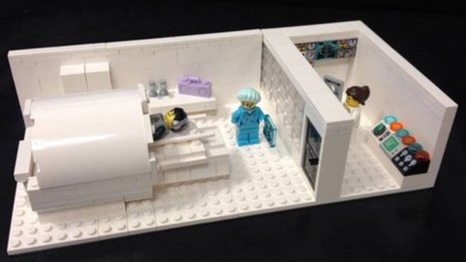
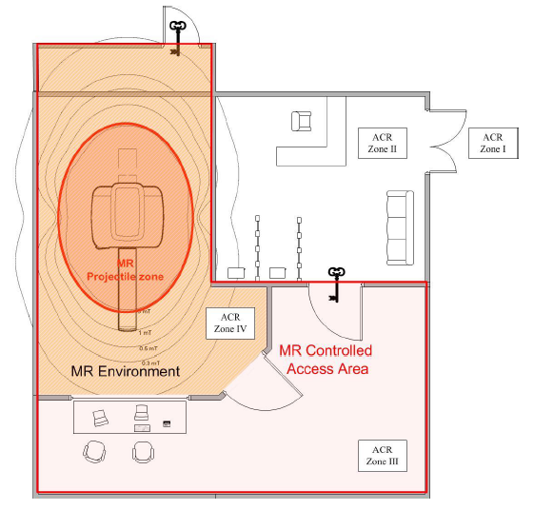
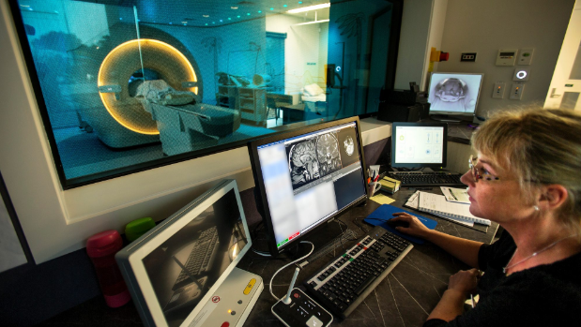
Staff categories: A
Category (A): MR OPERATOR - operate, maintain or modify the MRI equipment
e.g. radiographers, physicists, service engineers, radiologists.
✓
✓
✓
✓

Slide 11
Staff categories: B
Category (B): Personnel who do not fall into category (A) but are present with a volunteer or patient during scanning
e.g. radiologists, anaesthetists, nurses, HCSWs
✓
✓
✓
✗

Slide 12
Staff categories: C
Category (C): All staff who are required to enter the MR ENVIRONMENT when scanning is not taking place. Supervised whilst in MR environment
e.g. dedicated cleaning staff, estate maintenance staff
✗
✓
✓
✗

Slide 13
Staff categories: D
Category (D): All other staff who are required to enter the MR CONTROLLED ACCESS AREA but will not enter the MR ENVIRONMENT
e.g. clerical staff.
✗
✗
✓
✗

Slide 14
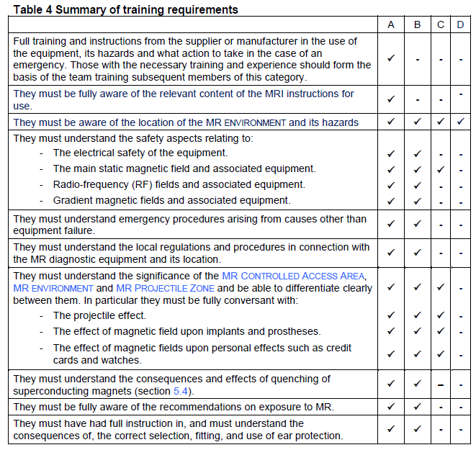
Training requirements for each category

