Slide 1
The Gd the Bad and the Ugly?
An Update on Gd Accumulation in the Brain
Dr David Brennan
dbrennan@nhs.net

Slide 2
Introduction
Gadolinium Based Contrast Agents (GBCA)
Available commercially since 1988
Used internationally in more than 100 million patients
30-45% of all clinical studies today
Acute adverse reactions – 0.08% - 0.12%*
Requirements
High relaxivity – Reduce T₁ and/or T₂
High stability – Avoid losing Gd⁺³ ion
Rapid clearance – Urinary and biliary
*Radiol Med. 2017 Mar 30. doi: 10.1007/s11547-017-0757-3

Slide 3
Introduction
Gadolinium Based Contrast Agents (GBCA)
Available commercially since 1988
Used internationally in more than 100 million patients
30-45% of all clinical studies today
Acute adverse reactions – 0.08% - 0.12%*
Requirements
High relaxivity – Reduce T₁ and/or T₂
High stability – Avoid losing Gd⁺³ ion
Rapid clearance – Urinary and biliary
*Radiol Med. 2017 Mar 30. doi: 10.1007/s11547-017-0757-3

Slide 4
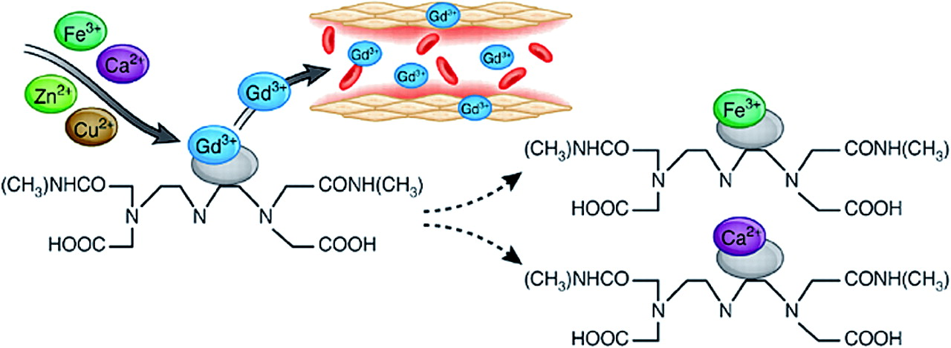
Toxicity – How?
Transmetallation
Dechelation of Gd³⁺ - Somehow the Gd³⁺ is released by the trapping molecule
In vivo there are other metal ions that ‘compete’ with Gd³⁺
Na⁺, K⁺, Mg²⁺, Ca²⁺, Fe³⁺, and Zn²⁺
Suggestion is that Zn²⁺ is the main source of transmetallation
http://cjasn.asnjournals.org/content/4/2/461/F2.expansion

Slide 5
Toxicity – How?
‘Free’ Gadolinium is toxic
Nephrogenic Systemic Fibrosis (NSF)
Skin and joint issues
Almost always associated with poor renal function
Gadolinium Deposition Disease (GDD)
Bone pain, headaches, ‘brain fog’
Not associated with renal function
Real?
GDD evidence currently anecdotal
Patient advocacy group
https://gadoliniumtoxicity.com/

Slide 6
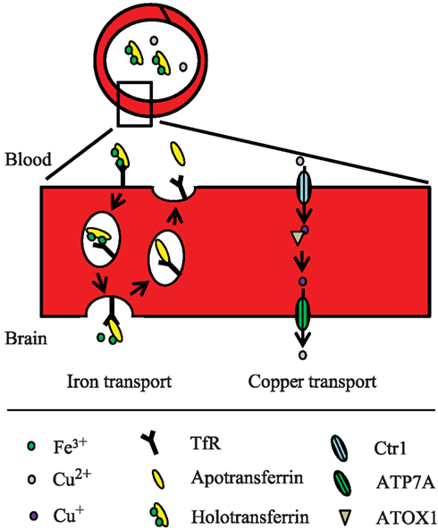
What About the Brain?
Blood Brain Barrier
Should prevent unwanted material entering brain
Brain does need metals, i.e. Zinc, copper, iron etc
Pathway for Gd³⁺ via ‘metal transporters’
Pharmaceutical Research 24(9):1745-58 (2007)

Slide 7
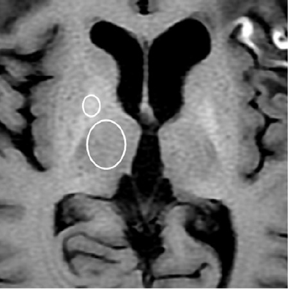
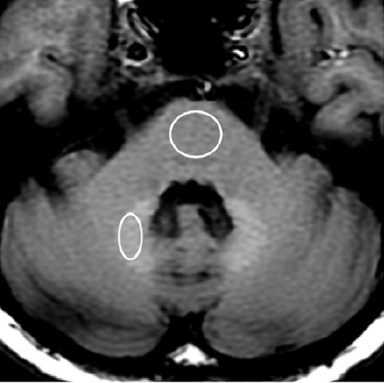
Do We See Gd in the Brain?
Globus Pallidus
Dentate Nucleus
Normal Kidney Function
Radiology. 2014 Mar;270(3):834-41

Slide 8
Do We See Gd in the Brain?
Study* measured T1 Hyper signal intensity in 13 patients (> GBCA 35 doses)
Dentate Nucleus, Globus Pallidus, Substantia Nigra (100%)
Posterior Thalamus (92%)
Red Nucleus, Colliculi (77%)
Superior Cerebellar Penduncle (54%)
Caudate Nucleus (31%)
Whole Thalamus (23%)
Putamen (15%)
Other areas suggested with > 50 doses GBCA
Histological Gd has been detected at > 4 doses GBCA
*Radiology. 2017 Feb;282(2):516-525

Slide 9
Is all Gd as Bad and as Ugly?
Four main types of GBCA
Ionic Linear
Non-Ionic Linear
Ionic Macrocyclic
Non-Ionic Macrocyclic

Slide 10
Is all Gd as Bad and as Ugly?
Four main types of GBCA
Ionic Linear
Non-Ionic Linear
Ionic Macrocyclic
Non-Ionic Macrocyclic

Slide 11
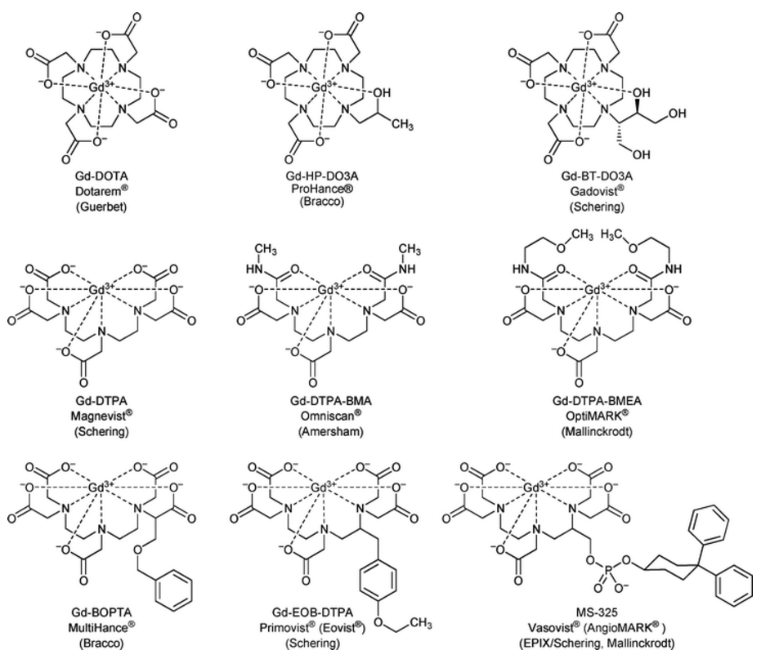
GBCAs

Slide 12
Is all Gd as Bad and as Ugly?
T1 Shortening only detected in linear GBCA
Omniscan, Magnevist, MultiHance etc
No T1 shortening detected
Dotarem, Prohance, Gadovist*
*Some disputed enhancement has been detected (not replicated)

Slide 13
Is Brain Gd Bad and as Ugly?
No known clinical neural correlate yet detected
Where Gd has been detected no neurological symptoms reported
However, due to reports of non-specific symptoms (GDD), care required
Further research required as well

Slide 14
To Gd or Not to Gd?
FDA and NIH (US) recommendations
“Limiting GBCA use to clinical circumstances in which the additional information provided by the contrast is necessary”
EMA (2017)
Continuing to evaluate the risk of Gd deposition
Pharmacovigilance Risk Assessment Committee (PRAC)
PRAC will provide recommendations

Slide 15
What should we do?
Continue to monitor developments
Obtain information on previous GBCA administration
Be more critical on the need for GBCA,
Especially in paediatrics
Preferentially use macrocyclic GBCAs
Paediatrics
Likely multiple doses required, e.g Crohns or MS
Report any T1 enhancement
But, don’t deny benefits of GBCA unnecessarily.

