Slide 1
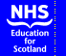
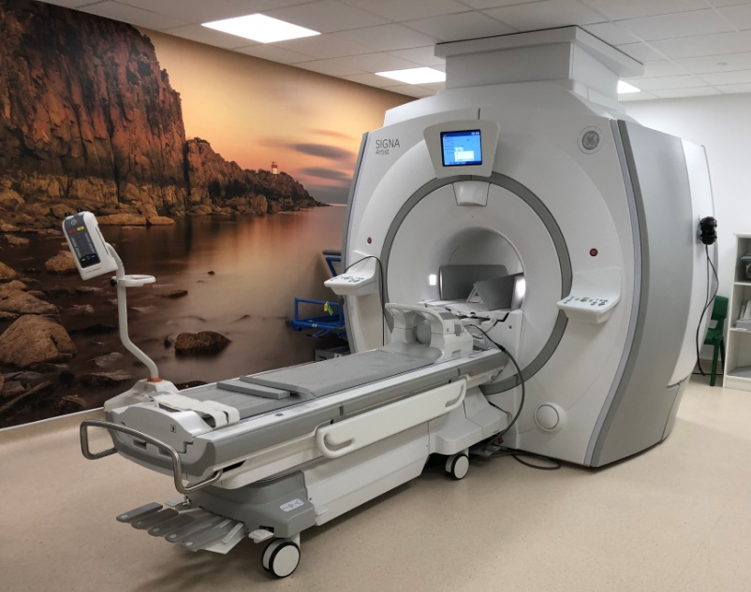
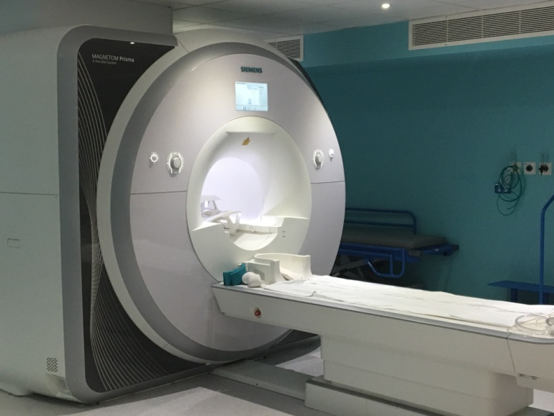
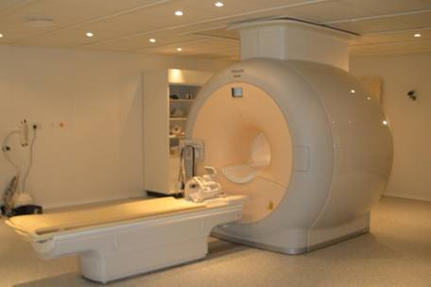
NES Healthcare Science: MRI Safety Training for Major Trauma Centre patients at QEUH
MRI Physics Group & Jacqueline Pursey, MRI Practice Educator
NHS GG&C

Slide 2
Opening statement: MRI Safety
MRI Units have the potential to be one of the most dangerous places in the hospital
People have been killed in MRI units and there are many cases of severe injuries occurring
However, incidents are very rare because of MR safety training and safe working practices
It is possible to work safely in the MRI Magnet room
The magnetic field and other dangers due the MRI scanner must be understood and respected

Slide 3
Contents
Safety Guidance and Training requirements
MRI safety zones and QEUH layout
Equipment labelling
Risks associated with MRI Scanners
Unit safety including emergency procedures
Risks to patients with implants
QEUH equipment considerations
The MR Pause
Advice on scanning pregnant patients
Incident reporting

Slide 4
MRI safety guidance and training requirements

Slide 5
Aims and Objectives
This resource aims to:
  Ensure you are aware of the risks when working in a MRI unit
  Ensure you are aware of your permissions and responsibilities as Category B staff
  Direct you to additional resources for further reading/discussion

Slide 6
Learning outcomes
After competing this module you should be able to:
  Describe the main hazards surrounding MRI
  Understand your role in MRI Safety
  Work safely in an MRI unit
  Know where to access further information, particularly information specific to your site

Slide 7
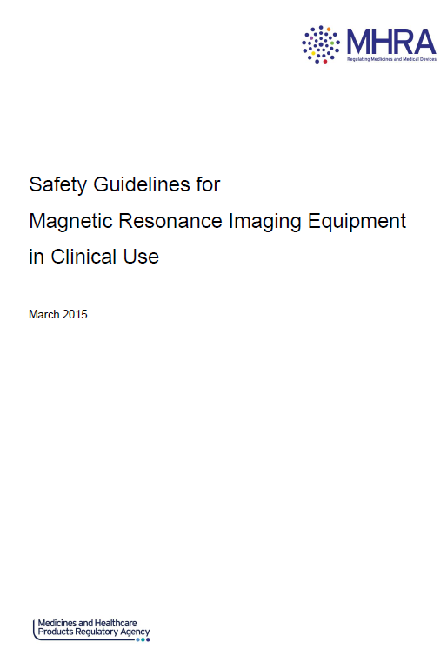
Guidance
MHRA guidelines for safe use of clinical MRI
Discusses risks of MRI
Advice and best practice
Categories of staff
Training
requirements for staff
Source: MHRA
Notes:
Source MHRA: MHRA guidelines for safe use of clinical MRI

Slide 8
What does Category B mean?
MHRA guidelines define Category B as:
“Personnel who do not fall into category (A) but are present with a volunteer or patient during scanning such as radiologists, anaesthetists and nurses.”
Effectively, Category B staff can access all areas of the MRI Controlled Access Area unsupervised but do not operate the MRI scanner.
This is reflected in the training requirements...

Slide 9
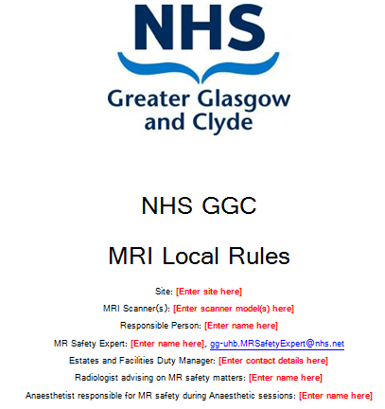
Local rules
All Category A and B staff are required to read and sign the local rules
Local rules include information on emergency procedures
Ask your MRRP, Designated Person or MRI Clinical Scientist if you have any questions

Slide 10
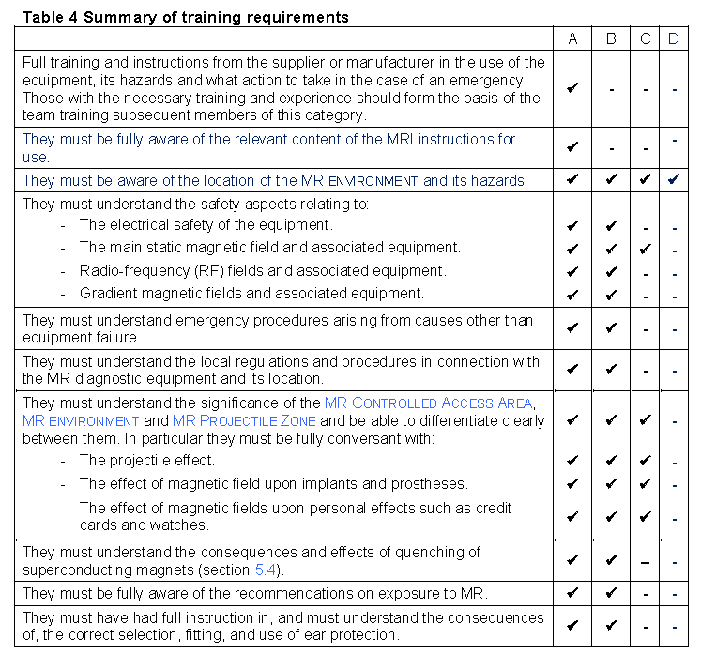
Training requirements
Source: MHRA
Notes:
Source MHRA: MHRA guidelines for safe use of clinical MRI

Slide 11
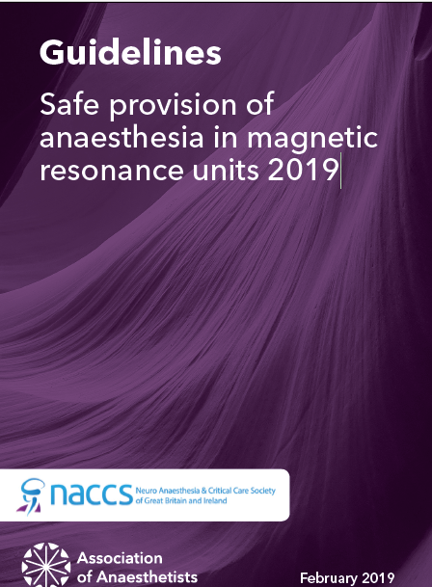
GA and MRI
Safe Provision of anaesthesia in MRI, 2019
Prepared by: Association of Anaesthetists
Neuro Anaesthesia and Critical Care Society of Great Britain and Ireland
Notes:
Source MHRA: MHRA guidelines for safe use of clinical MRI

Slide 12
MRI safety zones and QEUH MRI layout

Slide 13
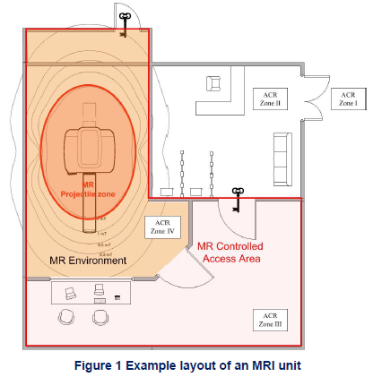
MRI zones (From MHRA)
Controlled Access Area (CAA): Unsupervised access must be restricted to trained and approved staff
CAA layout highlighting magnetic field
lines should be displayed in your control
room and in your local rules
Magnet Room or MR environment:
Typically contains the 5 Gauss line, only
Cat A or B can enter unsupervised
5 Gauss is the magnetic field strength
that may affect a medical device e.g. a pacemaker
Source: MHRA
Notes:
Source: MHRA

Slide 14
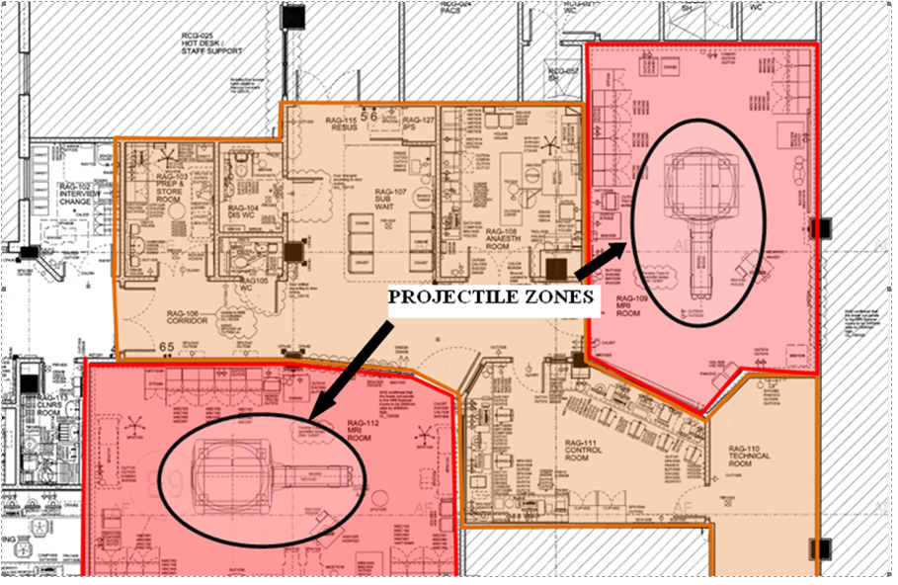
QEUH MRI layout
MRI, CAA entrance
The two rooms outlined in red are each known as a ‘Magnet room’. The dangerous magnetic field is present throughout this entire area.

Slide 15
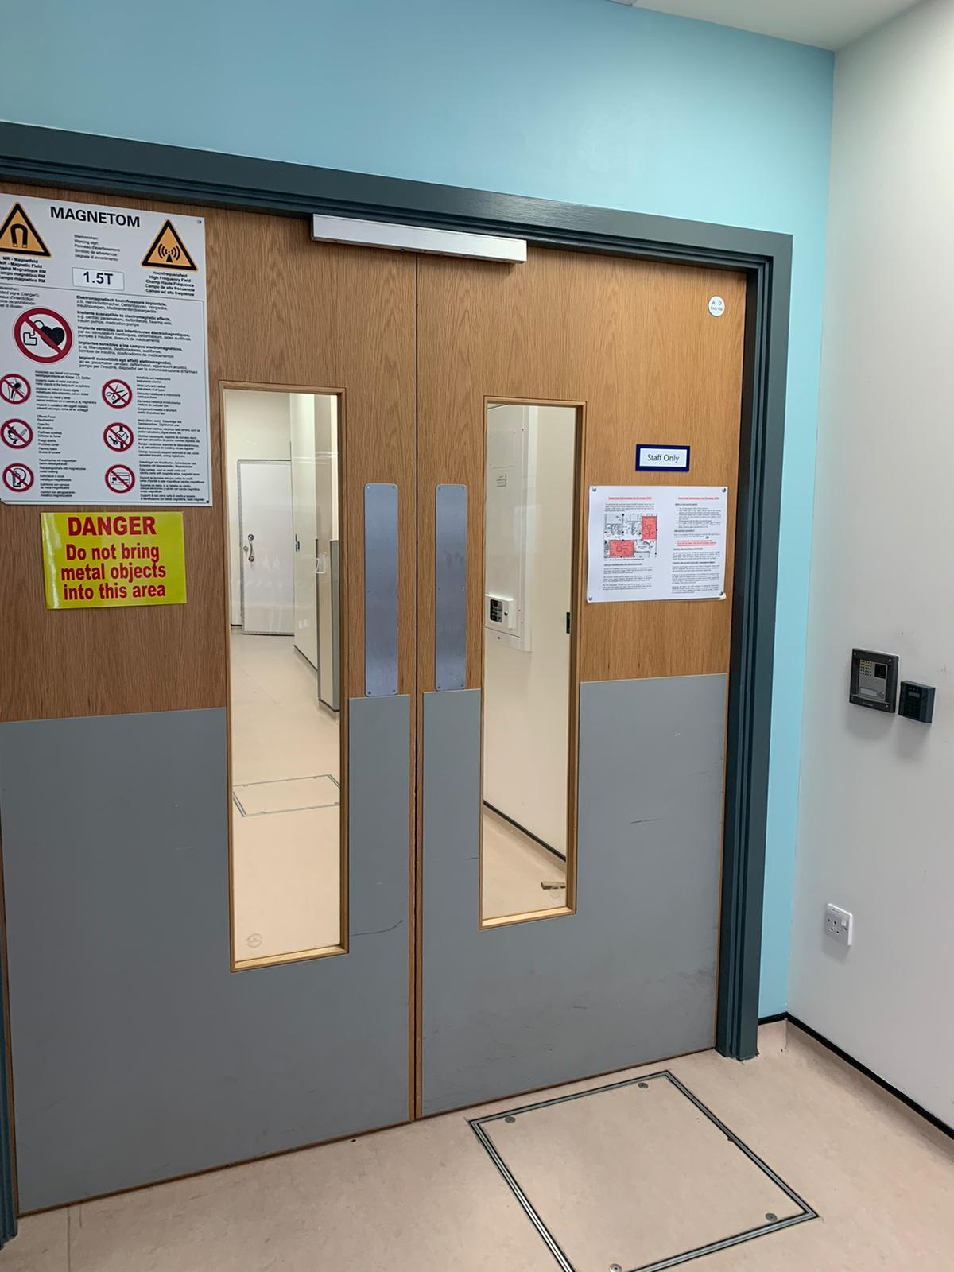
QEUH Controlled Access Area (CAA)
Entrance to CAA
Only MR trained staff can work unsupervised beyond this point
Staff and patients must complete MR safety checklist completed prior to entering

Slide 16
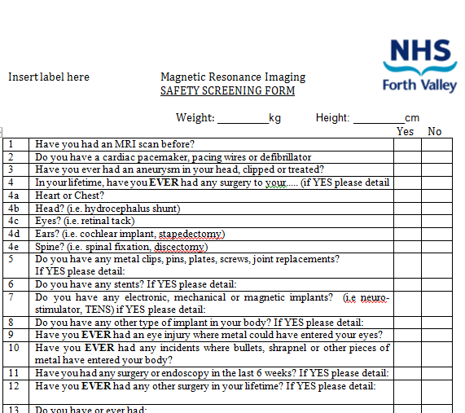
Patient and staff safety
MRI safety checklist
Staff updated annually
Inform MR lead to
relevant changes to
your medical history
Category A staff are responsible for completion of MRI safety checklist with patients

Slide 17
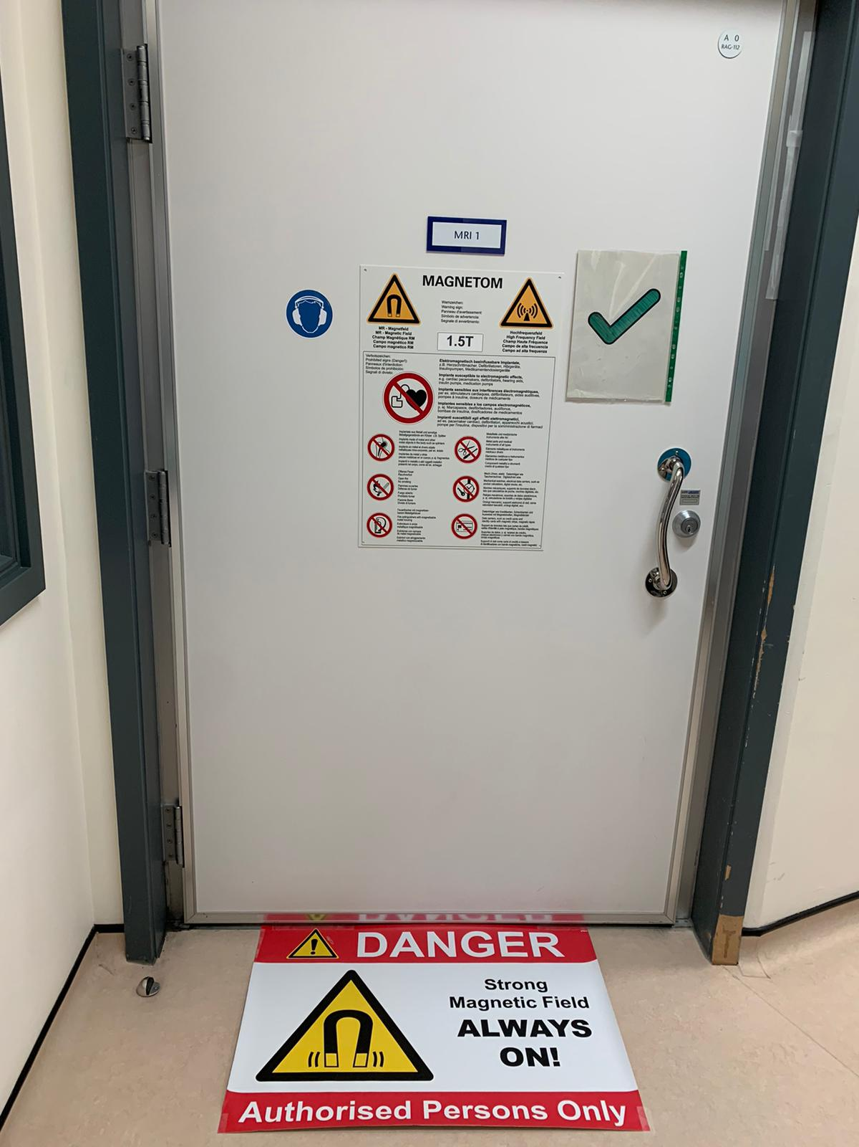
The Magnet Room
Magnetic field is a major risk beyond this point
Only MR safe/ MR conditional items beyond this point
MR Conditional?
  Know the conditions
No MR unsafe objects beyond this point
No label means you should assume MR unsafe

Slide 18
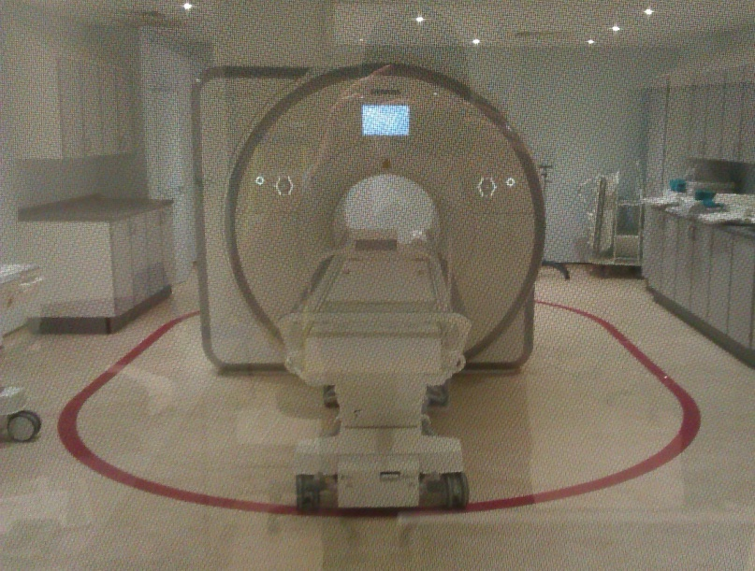
The Projectile Zone
An oval area within Magnet room denoted by red line on floor
Keep patient monitoring equipment outside this zone

Slide 19
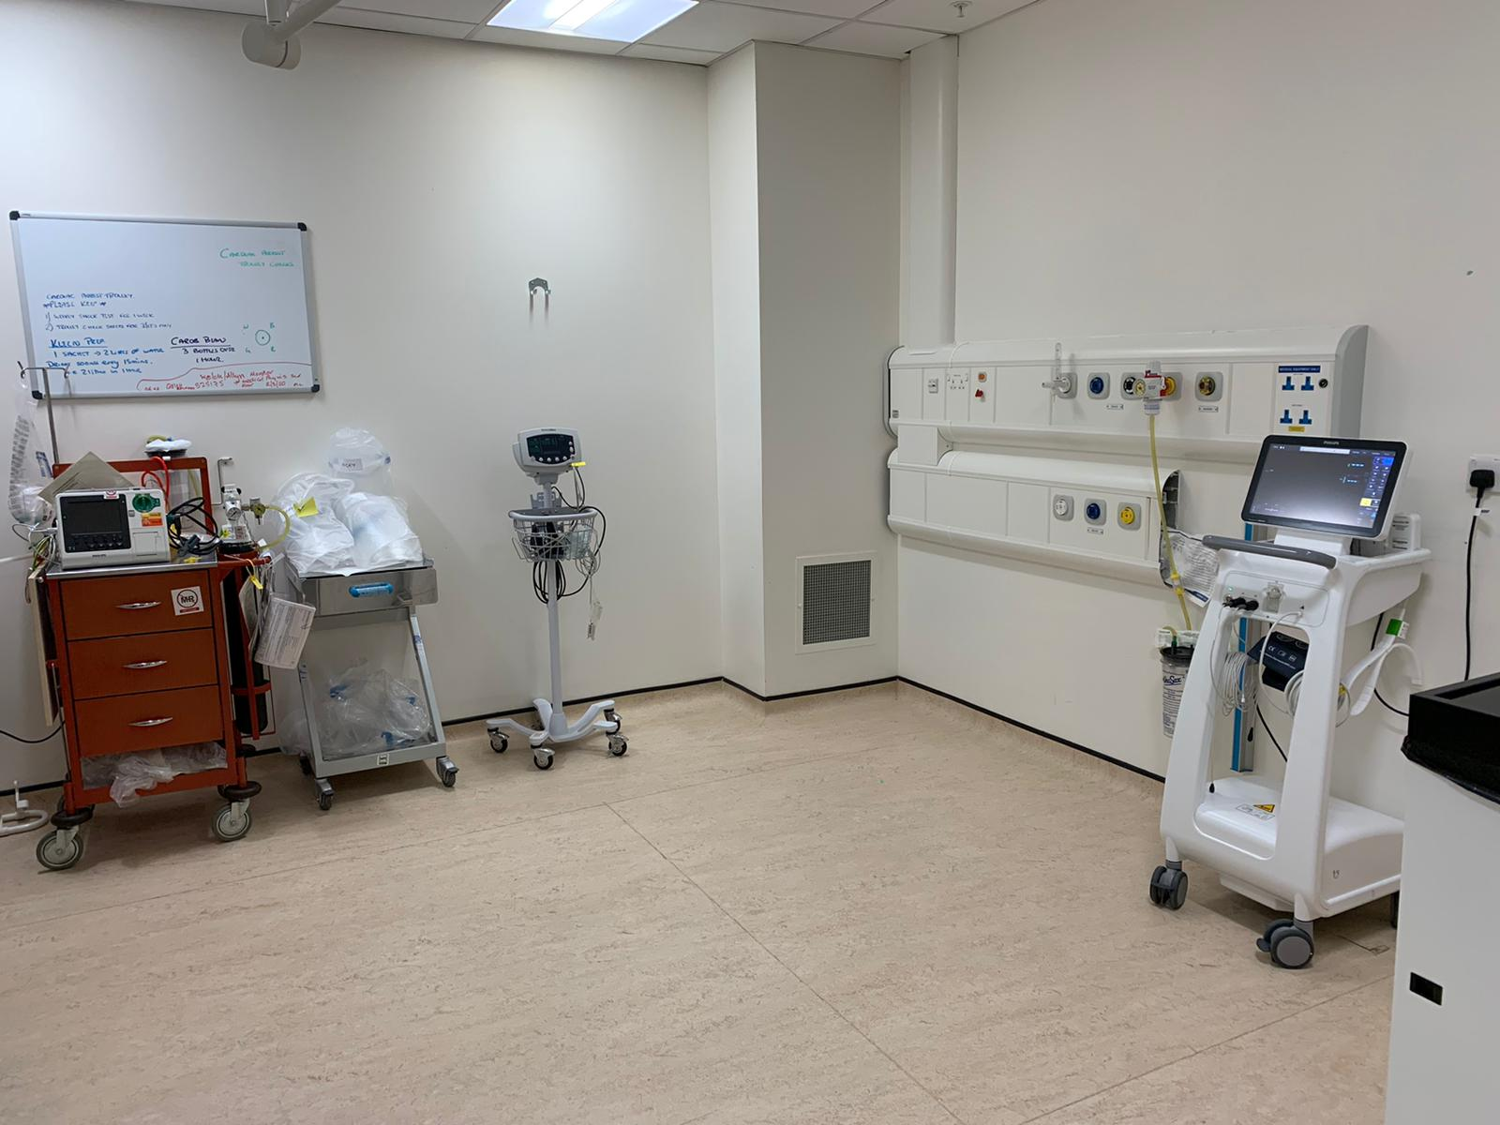
The MR preparation ‘prep’ Room
MR prep room
Monitoring equipment stored here
For MTC patients, perform ‘MRI Pause’ before leaving prep room
In event of patient cardiac arrest patient removed from magnet room to here

Slide 20
MRI equipment labelling

Slide 21
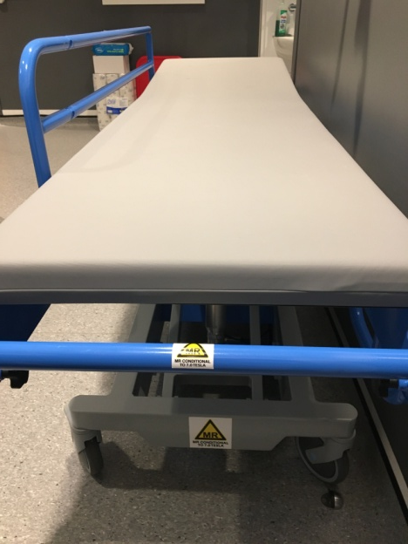
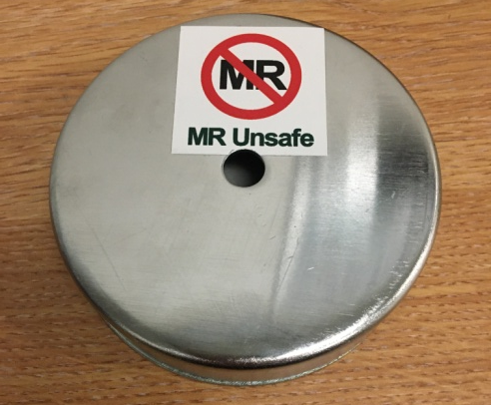
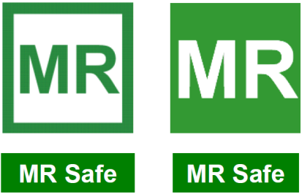
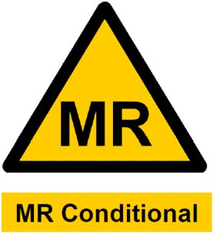
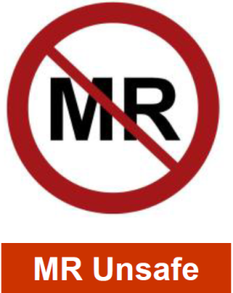
Labelling equipment
MRI Safe: can be taken into the Magnet room
MRI Conditional items: you must follow the conditions of use
MRI Unsafe: do not take into Magnet room
Unlabelled? Assume MRI Unsafe, speak to radiography staff
Ensure you are safe to enter the Magnet room each time you enter
Source: MHRA
Notes:
Source MHRA: MHRA guidelines for safe use of clinical MRI

Slide 22
Risks of MRI

Slide 23
Risks of MRI
  The risks of MRI are derived from 3 different components of the MRI hardware
  The Static magnetic field
  The RF power
  The Imaging Gradients

Slide 24
Risks of the static magnetic field

Slide 25
Static Magnetic Field
Always on
Silent
Invisible
Is a risk from the Magnet Room entrance
Strong pull and rotational forces on ferrous objects
May cause vertigo and/or nausea

Slide 26
Static Magnetic Field Incidents
2001, 6 year old boy was killed during an MRI examination
MRI Unsafe Oxygen tank introduced to Magnet Room by staff
Tank flew to centre of magnet and struck patient
Notes:
Can also mention relative of patient who was killed in 2018 after reportedly being asked to bring an MRI Unsafe Oxygen tank into the room (https://www.theguardian.com/world/2018/jan/30/mri-scanner-india-death)

Slide 27
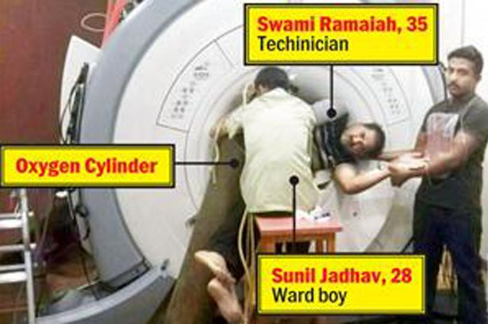
Static Magnetic Field Incidents
  In 2014, two employees suffered injuries after an oxygen cylinder was brought into the Magnet Room
  MRI “projectile” incidents have the potential for serious injury or death
  Other previous projectile incidents have involved scissors, drip stands and hair clips being brought into the Magnet Room
Credit: Central European News
Notes:
Mention that the quench button failed and staff stuck for 4 hours?
Mention 20 members of staff tried to pull cylinder away to free them but couldn’t?
Source: https://mumbaimirror.indiatimes.com/mumbai/other/hospital-says-ge-took-4-hrs-for-a-30-sec-job/articleshow/45116475.cms

Slide 28
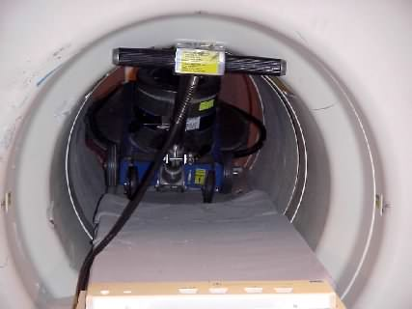
Turning off the static magnetic field - non emergency
The static magnetic field can also be removed by the process of a ‘controlled ramp down’
Less expensive and damaging to the scanner than quench
Performed by service engineers
Used when decommissioning magnet or when large ferrous object stuck to scanner
Floor polisher sucked into scanner.
Ramp down (not quench) to be done in situations like these
Notes:
Source: Get FV / floor buffer image….

Slide 29
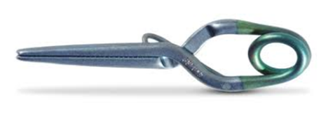
Static Magnetic Field
Incidents from patient implants/retained metal:
Intracranial aneurysm clip: 2 patient’s have died
Dislodgement of an iron filing in a patient's eye during MR imaging resulted in vision loss in that eye
Notes:
Aneurysm clips Dec 2016 and Klucznik et al, 1993. Literature stored in Cat B TURAS folder.
Are the eye ones local? I’m struggling to find concrete cases published online
Ref: Kelly WM, et al. Ferromagnetism of intraocular foreign body causes unilateral blindness after MR study. Am J Neuroradiol 1986;7:243.

Slide 30
Risks of the RF power

Slide 31
RF power
Pulses of RF power are transmitted into the body in order to get MR images
Unwanted interactions with medical devices
Burns can occur in MRI under a number of circumstances:
  Skin to skin contact
  Skin to magnet bore contact
  Inappropriate use of monitoring equipment
  Interactions with implants, cosmetics, tattoos or skin patches

Slide 32
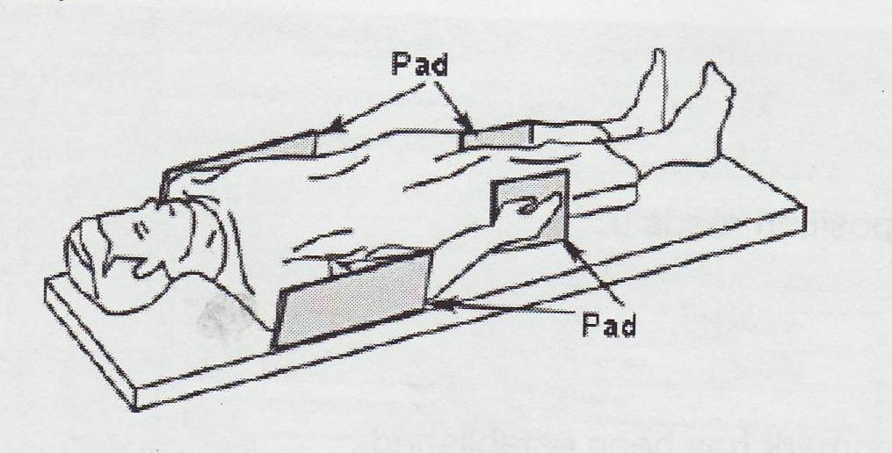
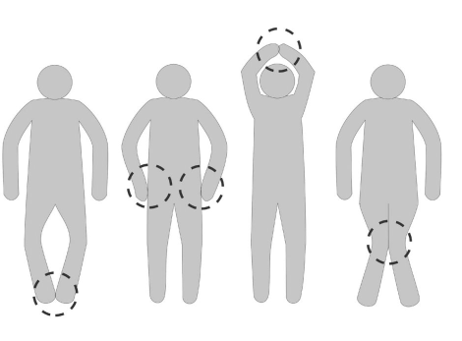
RF power
Patients can receive burns even with no implant, rare but can occur
Appropriate patient positioning and use of pads minimises risk
Appropriate choice of operating mode of the scanner limits this risk (e.g. Normal Mode has lower risk of burns compared with First Level Mode)
Source: Siemens Healthineers and GE Healthcare
Notes:
Source: GE healthcare and Siemens Healthineers

Slide 33
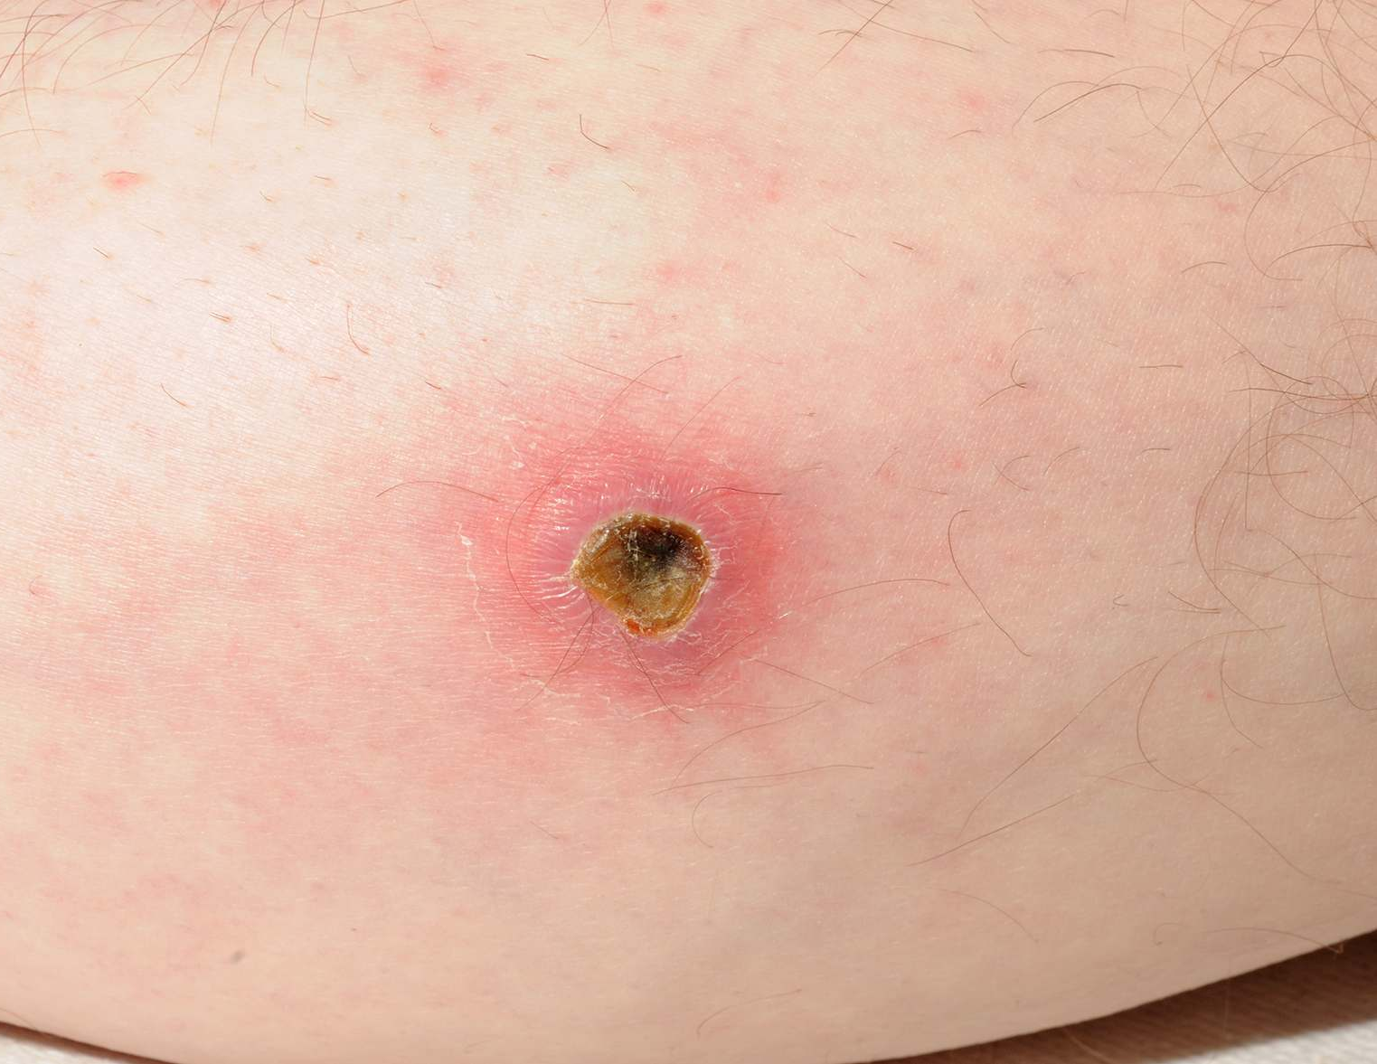
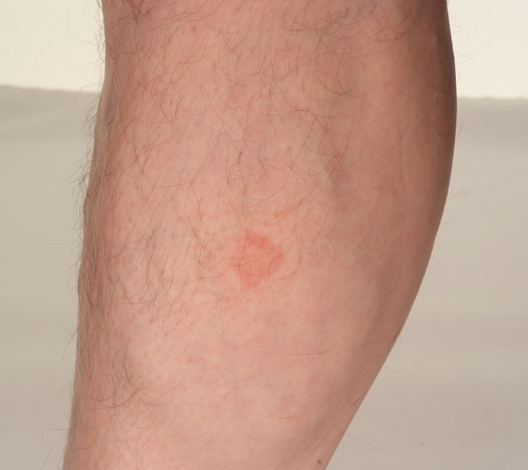
RF power
Credit: Knopp et al, Radiology (1996)
& Muriel Cockburn, NHS Highland
Notes:
Source:
Bottom 2 images shared with permission Muriel Cockburn, NHS highlands

Slide 34
MR safety of patient devices and monitoring equipment
A major risk of RF power is the risk of heating and burns from MRI unsafe devices or equipment.
The checking for hidden items on trolleys and wheelchairs prior to entering the magnet can be used to detect MRI Unsafe equipment.
Ensure any monitoring equipment taken into the magnet room is MRI Conditional or MR Safe.
Cables from monitoring equipment should not be in contact with patient skin.
Cables should be fed straight out via the centre of the bore of the magnet.

Slide 35
Example of pulse oximeter related burn
In 2007, MRI Unsafe pulse oximeter was left attached to 5-week-old baby during MRI scan. Cable may have been looped or under clothing.
Baby sedated (to prevent movement)
Presumably, probe not spotted when baby brought down to the MRI unit.
Trolley checks essential
Baby received fourth-degree burn to
arm, resulting in amputation.
Notes:
Haik, Josef, et al. "MRI induced fourth-degree burn in an extremity, leading to amputation." burns 35.2 (2009): 294-296.
No mention of other monitors. Threading through babygrow sleeve due to movement and probe not spotted are only hinted in publication so I made these speculative statements instead.

Slide 36
RF power
Risk occurs when scanner is acquiring images
Responsible for heating to patient and devices
Scanner limits the heating to a patient by using their height and weight
RF power may also cause unwanted device interactions

Slide 37
Risks of the time varying imaging gradients

Slide 38
Time varying gradients
Gradients are used to localise the signals that are used to form the MR images.
Risk occurs when scanner is acquiring images
Peripheral Nerve Stimulation (PNS)
Heating and unwanted interactions with medical devices
Appropriate choice of operating mode of the scanner limits this risk (e.g. Normal Mode has lower risk of PNS compared with First Level Mode)
Responsible for acoustic noise

Slide 39
Time varying gradients
Acoustic noise
Patients must have protection
Other persons in the magnet room during scanning must also wear ear protection

Slide 40
QEUH equipment considerations

Slide 41
Equipment considerations : general
MR unsafe objects must not be taken into the Magnet room
Any drawers or storage compartments on any pieces of equipment to be kept empty
Do not mix components from different pieces of equipment
Equipment labelled as MR conditional
  Know and follow the conditions

Slide 42
QEUH equipment considerations
Bbraun Spacestation for infusion pumps
MR Safety conditions
Keep outside projectile zone
Note that pumps are ferrous so ensure clipped into place properly
Door to pump enclosure must remain closed during scanning
Do no change pumps in the magnet room, only change in prep room

Slide 43
QEUH equipment considerations
Phillips/Invivo Expression 400 patient monitor
MR Safety conditions
Keep outside projectile zone
Ensure 3rd party consumables are also MR safe or conditional e.g. ECG pads
  Incorrect ECG pads can lead to patient burns

Slide 44
QEUH equipment considerations
Hamilton Ventilator MR Safety conditions
MR conditional up to 50mT
Keep outside projectile zone

Slide 45
The MRI Pause

Slide 46
The ‘MR Pause’
a safety feature to ensure everyone and everything entering the magnet room is safe for the magnet room
occurs prior to the patient leaving the prep room to enter the magnet room
Everyone present stops to do this

Slide 47
The ‘MR Pause’
Check the following for MR unsafe objects
  Yourself (everything out of pockets, no jewellery or fitness equipment (i.e. ankle weights or weighted vests are MR unsafe))
  The patient, including their hair and their clothes
  Any patient ancillary equipment: e.g. supports / splints / vacuum bags
  The trolley, pillows and under bedding
Only MR safe/MR conditional equipment connected to patient
Ensure correct patient positioning
Patient must have ear protection in place
Record that MR Pause was done on patient record system e.g. CRIS/Opera

Slide 48
Emergency procedures

Slide 49
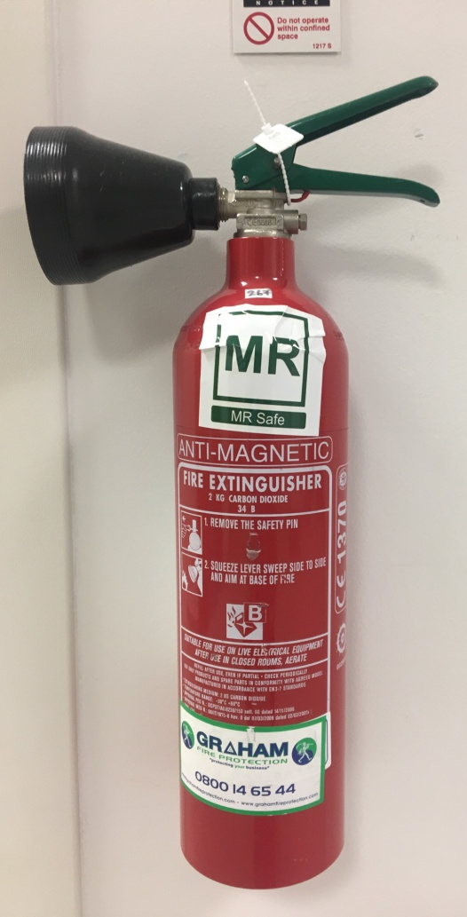
Emergency Procedure: Fire in the MRI Unit
Know the locations of MRI-safe fire extinguishers
Ensure the type of fire extinguisher is appropriate for the type of fire
Know and rehearse your emergency patient extraction procedures
Know the location of and when to use the quench and electrical isolation buttons in the event of a fire
Notes:
Flood, fire or electrical fault
Source : IPEM

Slide 50
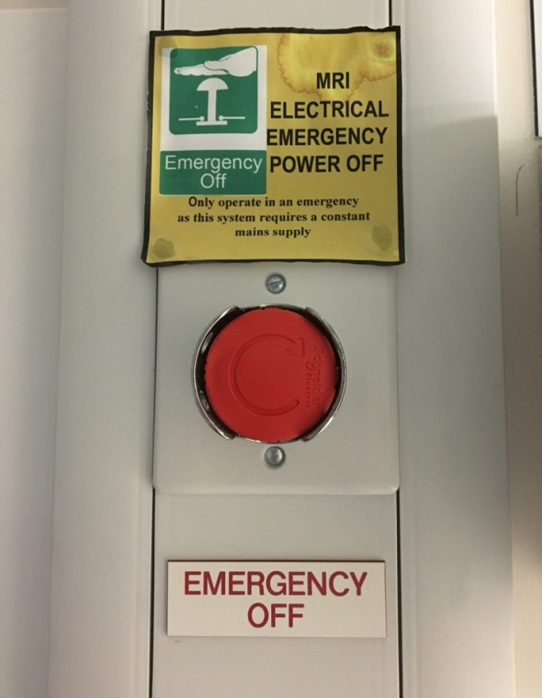
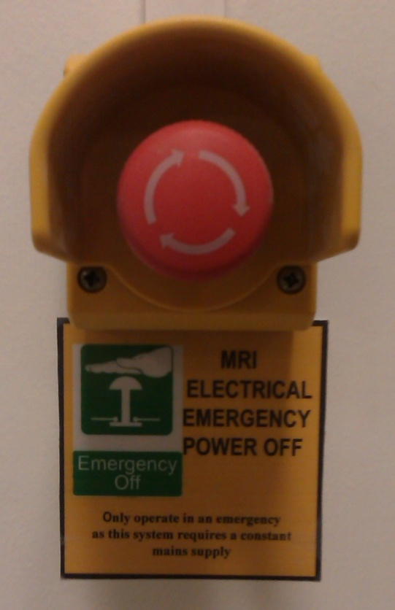
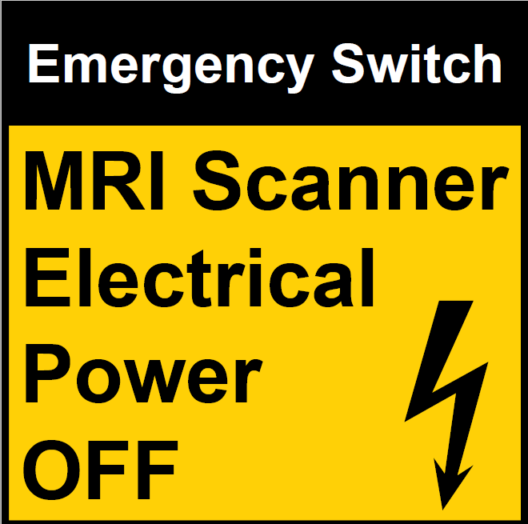
Emergency Procedure: Electrical isolation
Electrical isolation button- used to cease electrical power to MR scanner (including equipment in technical room)
To be used in the event of flood, fire or electrical fault
Know the location of these buttons in your unit
Source: IPEM
Notes:
Flood, fire or electrical fault
Source : IPEM

Slide 51
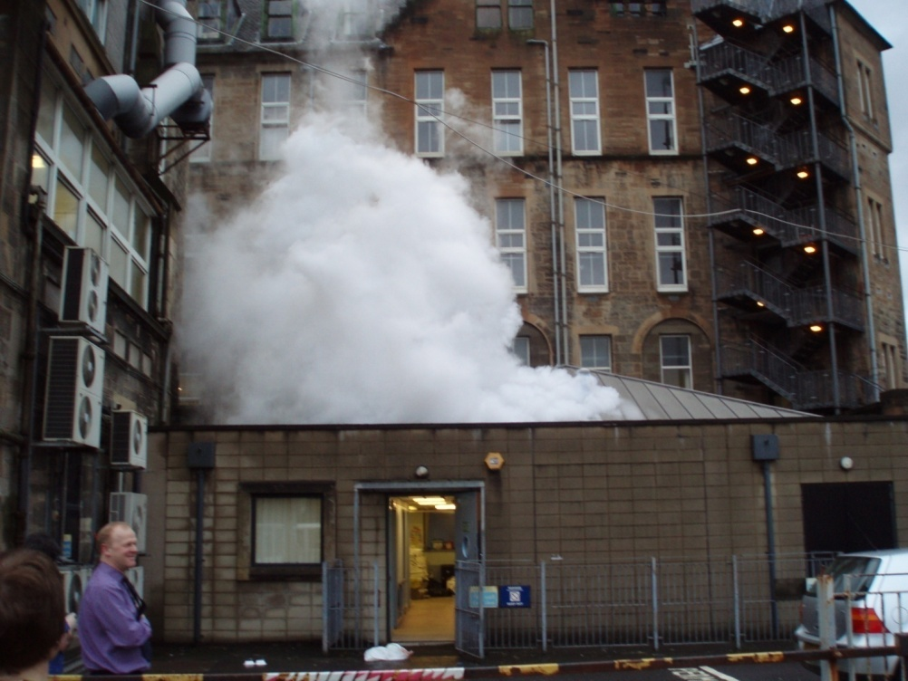
Emergency Procedure: Turning off the static magnetic field - ‘Quenching’
Quenching the magnet turns the magnet off
Know the location of these buttons in your unit
This must only be done in an emergency:
  Person in grave danger due to being trapped by large metallic object.
  Significant fire in scan room or adjacent rooms

Slide 52
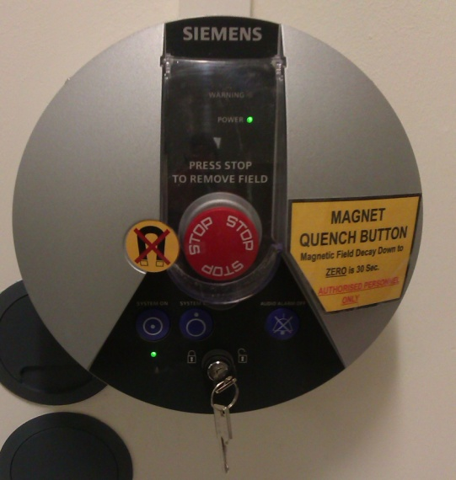
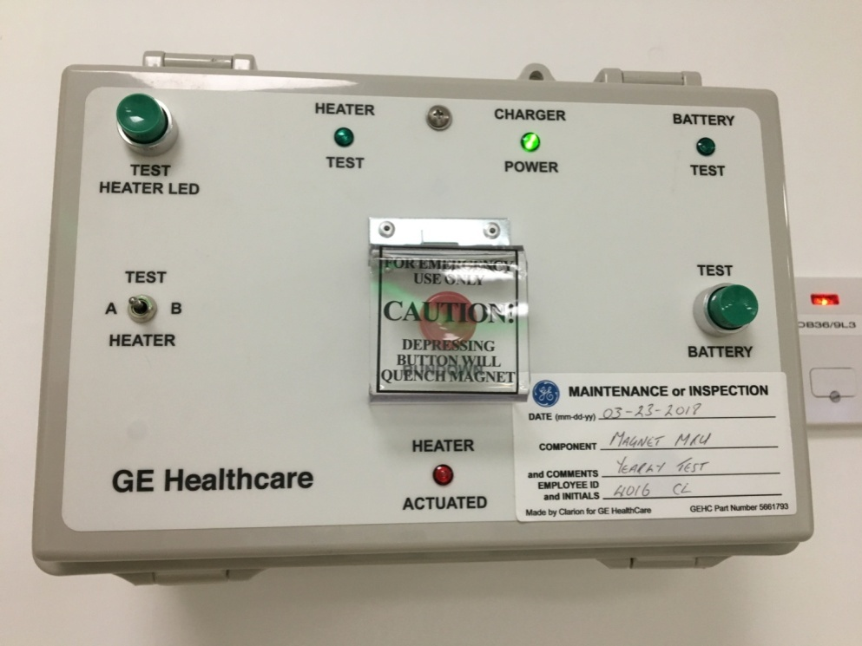
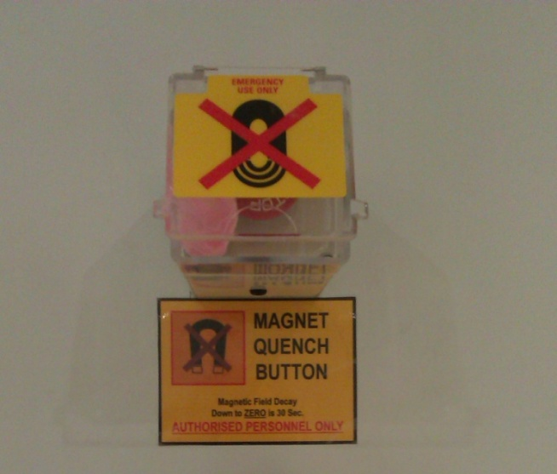
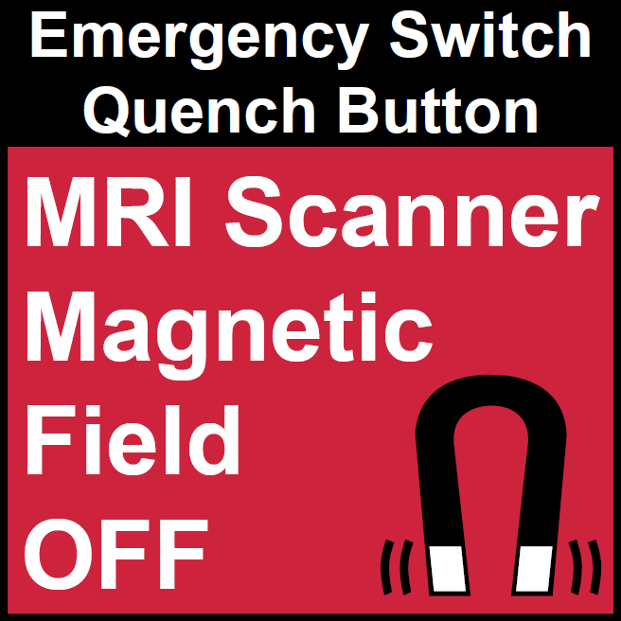
Emergency Procedure: Quench buttons
CAN TAKE BETWEEN 30 SECS TO 2 MINUTES FOR MAGNETIC FIELD TO TURN OFF
Source: IPEM

Slide 53
Closing comments

Slide 54
MRI: report near misses and adverse incidents
Incidents are rare
Report MRI safety issues in a timely manner
Most common incidents are due to unsafe objects being taken into the magnet room and also heating and burns
Report through incident reporting system (e.g. Datix / IR1 safeguard)
Discuss with MRRP and MRSE whether reporting to MHRA via Yellow Card system appropriate

Slide 55
Advice on patient pregnancy and MRI
Patients who are pregnant can be scanned in ‘Normal operating mode’
Heating and acoustic levels should be minimised wherever possible
No distinction regarding trimester
Gadolinium based contrast agents and 1st level scanning mode not recommended during pregnancy and require risk : benefit consideration

Slide 56
Further guidance for staff
Pregnant staff
  Do not remain in magnet room during scanning
Anything else – ask the MR radiographer

Slide 57
MRI Safety (recap):
Your responsibilities
Ensure you are safe to enter the Magnet Room
Assist in ensuring anyone taken into the Magnet Room is safe for MRI (e.g. safety checklist approved by Radiographer, no MR Unsafe objects on their person)
Ensure anything you take into the room is MR Safe or MR Conditional (i.e. appropriately labelled)
If MR Conditional, follow the conditions
Otherwise assume item is MRI Unsafe
Seek advice from Radiographer
Be vigilant and challenge anyone you suspect of unsafe practices

