Slide 1
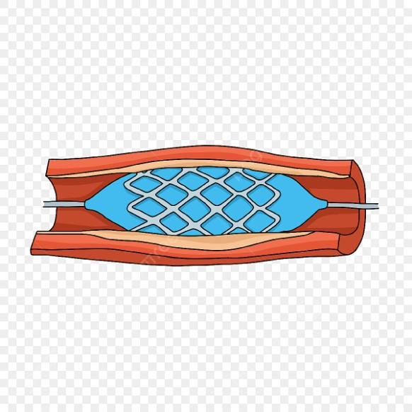
Non Coronary Vascular Stents
NHS Scotland GISP
Guidance Recording
Authors: Stephen Gandy, John Foster
Medical Physics Review: John Maclean
Radiography Review: Thomas Dockerty

Slide 2
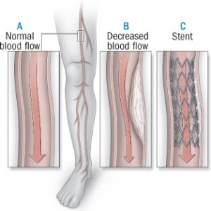
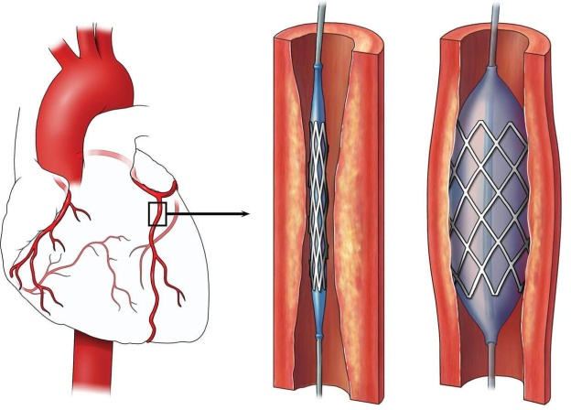
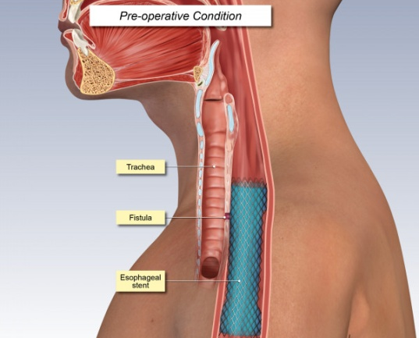
Overview
Overview provided to support the use of an NHS Scotland GISP for scanning of patients who have non-coronary vascular stents (NCVS’s) – i.e. associated with the cardiovascular system away from the heart
The review does not cover coronary stents, and neither does it cover any non-vascular stents (e.g. oesophageal stents)

Slide 3
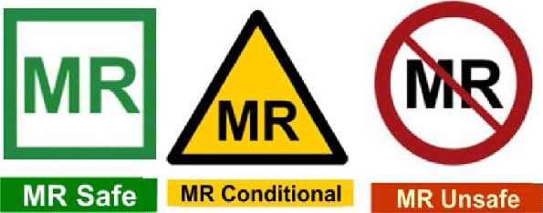
Key Questions
Can NCVS patients be scanned safely; or any required conditions?
Do the risks associated with NCVS MRI at 1.5T and 3.0T differ?
Would an MRI performed less than 6 weeks after stent implantation be safe to perform?
Would MRI in ‘normal mode’ be sufficient to mitigate RF heating risks?
Are multiple overlapping stents likely to pose an RF heating problem?
Are older stents likely to present a more serious MR safety issue than more modern models?
Are NCVS that are implanted internationally as MRI safe as those implanted in the UK?

Slide 4
Resources Used
Review of MRI safety.com
Review of UK MRI Mail Bases and Social Media Groups
Review of information provided by stent manufacturers
Review of the relevant peer-reviewed literature
Review of empirical evidence
Review of key internet searches

Slide 5
Risk – Static Field
Composition - nitinol, 316L stainless steel, or cobalt alloy. Less commonly, platinum, carbon, gold, or tantalum
Most stents exhibit non-ferromagnetic or weak ferromagnetic behaviour at both 1.5T and 3T
Evidence suggests that it is safe to scan patients with NCVS’s at 1.5T or 3.0T immediately after stent deployment, if clinical situation requires it
“Although MR may be deferred for 6 to 8 weeks in stent patients, there are no good clinical data or rationale to support this delay”
However, 6-8 week delay rule is a sensible prudent ‘first step’ to support the initial use of the GISP
Any NCVS implants that are <6 weeks post-implantation should be referred for standard MRI safety review

Slide 6
Risk - RF Power Deposition
A few NCVS have exposure limits as low as 0.5 W/Kg for 15 min of continuous scanning; ‘normal mode’ theoretically not enough
Cooling effect of blood flow - limits temperature rise during MRI
RF ‘critical length’ ~25 cm (1.5T), ~12 cm (3T). Overlapping stents, unlikely to form a true continuum
Empirical review – no identified MR safety events when in ‘normal mode’, but small delay between successive sequences may help to further minimise risk associated with continuous scanning
Recommended delay ~20 sec between successive sequences to avoid continuous scanning

Slide 7
Risk - Date & Geographical Location
Patients with vascular stents have been scanned safely using MRI since at least late 1990’s, probably for lot longer
No data to support using a date cut-off for NCVS deployment
No information of any NCVS’s that form contraindications to MRI at 1.5T or 3.0T, despite extensive reviews and plenty of empirocal evidence – no identified geographical restrictions

Slide 8
Summary Recommendation
Scanning may be performed at 1.5T or 3.0T for patients who have NCVS’s in-situ that have been deployed correctly and are functioning as intended, with the following conditions:
Normal mode of operation to minimise RF power deposition. A short delay (20 sec) to be routinely implemented between successive pulse sequences to avoid continuous scanning
Scanning may occur at any time after NCVS deployment, but if required within 6 weeks of implantation then it should be referred for a standard MR safety assessment.
No report of stent malfunction
1.5T or 3.0T
Implanted > 6 weeks ago
No report of implantation in a non qualifying country?
20 second gap between successive sequences

Slide 9
NCVS - Flow Diagram
Patient has NCVS
Is the device in place as expected, and functioning correctly?
Y
N
Has device been inserted for longer than 6 weeks?
Send for MR Physics Safety Review
Y
N
Scan at 1.5T or 3.0T in normal mode, and ensure 20 second gap between sequences
Send for MR Physics Safety Review

